Slide 1
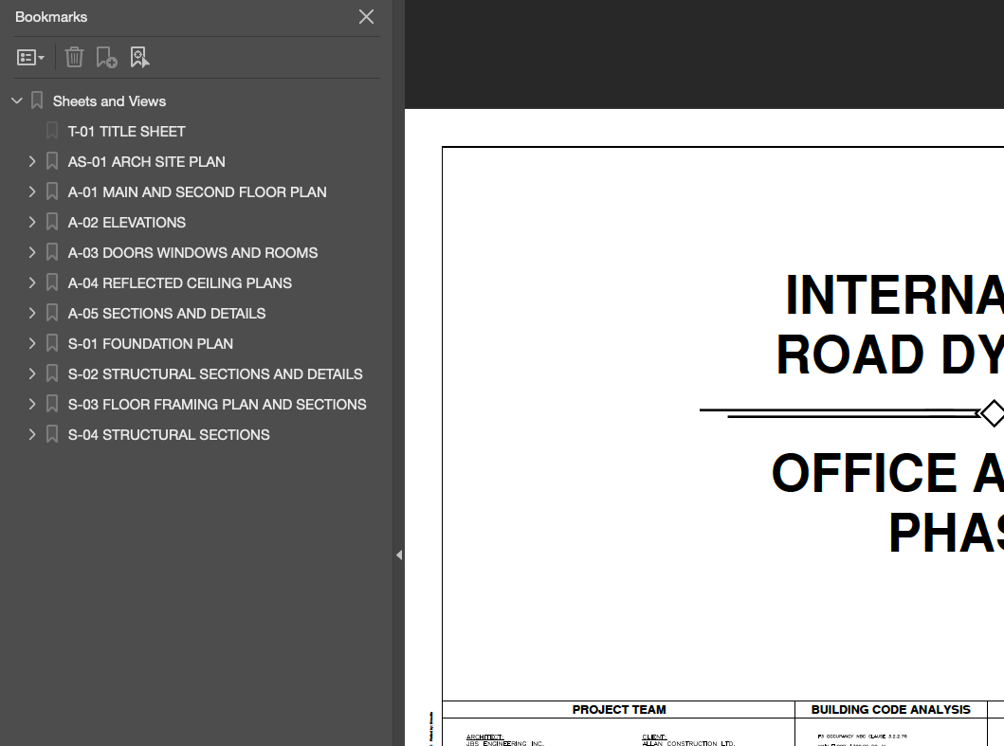
Sheet Number Recommendations
Use table of contents (bookmarks) whenever possible, especially if using numeric only sheets
Use the following format
[SHEET NUMBER] [SHEET TITLE]
If not using a table of contents, using an alpha/numeric sheet pattern will provide better accuracy in identifying sheet number
Do not change sheet numbers for resubmittals

