Slide 1
DPR Overview
City of Palm Bay

Slide 2
Review Packages

Slide 3
Review Package - Definition
Electronic organizational tool to collect documents for a review cycle. Review packages control when the public portal is open to accepting additional documents for review. Packages align to review cycles.
Notes:
Auto-routing plan reviews refer to a process where digital plan review software automatically routes construction project plans to the appropriate reviewers or stakeholders for evaluation and approval. This technology-driven approach eliminates the need for manual distribution of physical documents or manual assignment of reviewers, streamlining the plan review process and improving efficiency.

Slide 4
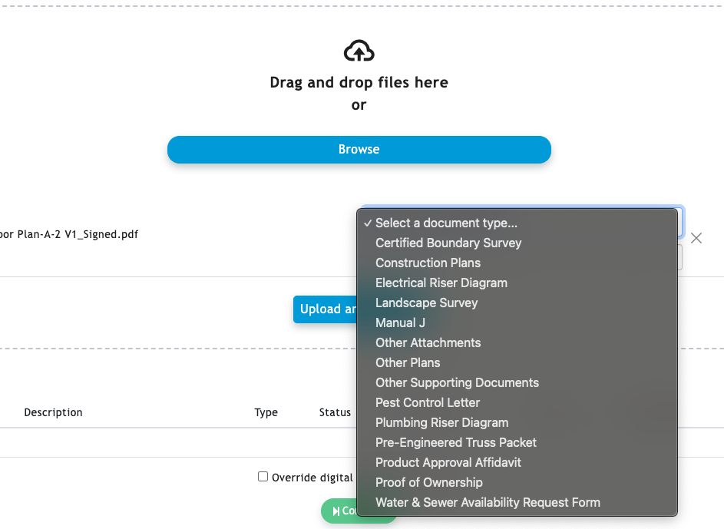
DPR File Type Roles
Plans
Supporting Document
Attachment

Slide 5
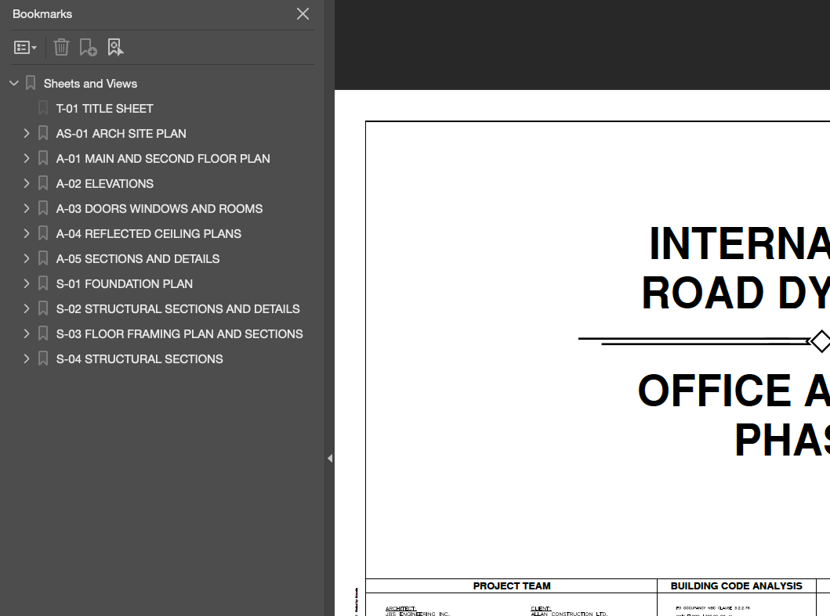
Sheet Number Recommendations
Use table of contents (bookmarks) whenever possible, especially if using numeric only sheets
Use the following format
[SHEET NUMBER] [SHEET TITLE]
If not using a table of contents, using an alpha/numeric sheet pattern will provide better accuracy in identifying sheet number
Do not change sheet numbers for resubmittals

Slide 6
Review Package Statuses
Status | Description | Next possible status(es)
New | Open for the customer in the public portal | Submitted
Submitted | The customer has submitted it, and it is now read-only in the public portal It can be reopened by the workflow or manually Sheets and documents will not yet appear on the Plans and Documents tabs | ReOpened Accepted
ReOpened | Open for the customer in the public portal Includes comments from the City communicating deficiencies | Submitted
Accepted | Ready for review Commits in sheet numbering, plans, and documents for review CANNOT BE REOPENED

Slide 7
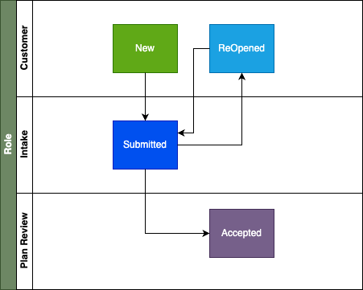
Review Package Statuses

Slide 8
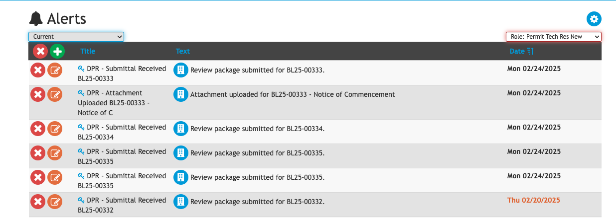
Alerts

Slide 9
Alerts - Roles

Slide 10
Plan Review

Slide 11
Review Disciplines
Review disciplines are mapped to review tasks found in iMS.
The Digital Plan Room displays the applicable disciplines in the current record’s review tasks.
Each discipline may be assigned a unique color.
A discipline may be mapped to more than one review task in iMS.

Slide 12
Review Disciplines

Slide 13
Test Record
BL25-00338
Sheet being resubmitted A-102

Slide 14
Issues, Conditions, Notes, Internal
Type | Description
Issues | Requires a response from the customer and corrected documentation
Conditions | Comment for which the plan review will not be rejected, opened for awareness for subsequent phases Inserted to the front of approved plans Markups appear on the approved documents
Notes | General comment Markups appear on the approved documents
Internal | Comments are internal only and never shared with the customer

Slide 15
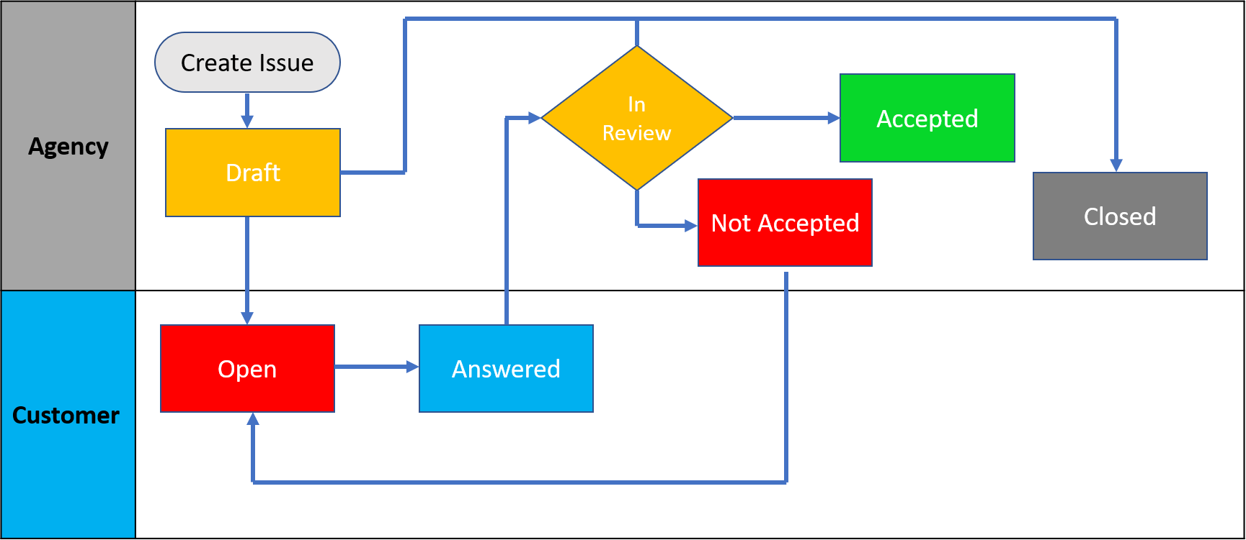
Issue Life Cycle

Slide 16
Comment Publishing
Type | Description
Closed Cycles | Comments are published once the Review Cycle is completed All comments are released at once (All review tasks are complete, but not all approved)

Slide 17
Print Sets

Slide 18
Print Sets
Automated and dynamic PDF creation of Plans and Documents from the Digital Plan Room
Approved Documents may be stamped manually or automatically
The customer is notified documents are ready for downloading

Slide 19
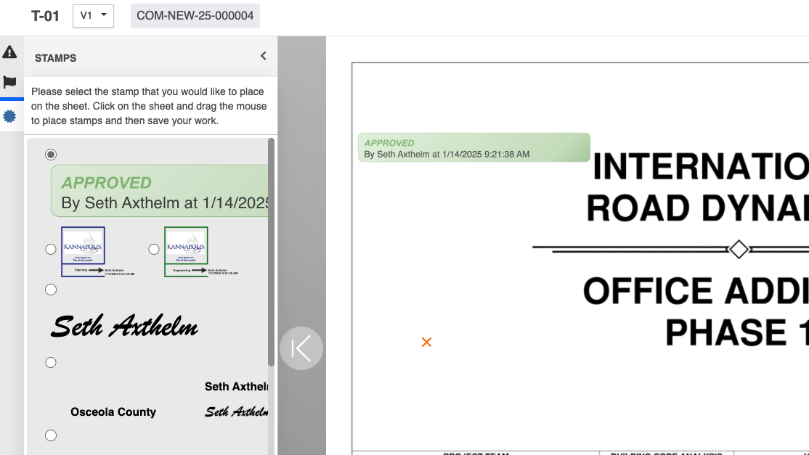
Stamps
Manually apply to sheets/pages on plans and documents
May include any dynamic data from the application

Slide 20
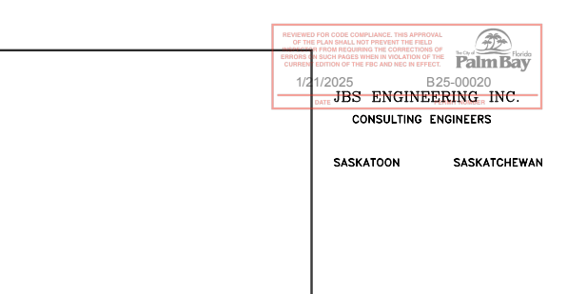
Watermarks
Automatically applied at print set creation
Configured for placement and opacity
May include any dynamic data from the application

Slide 21
Comment Library

Slide 22
Comment Library
Pre-defined/loaded library of comments organized into books and chapters
Comments may be configured with references to code and ordinance sections

Slide 23
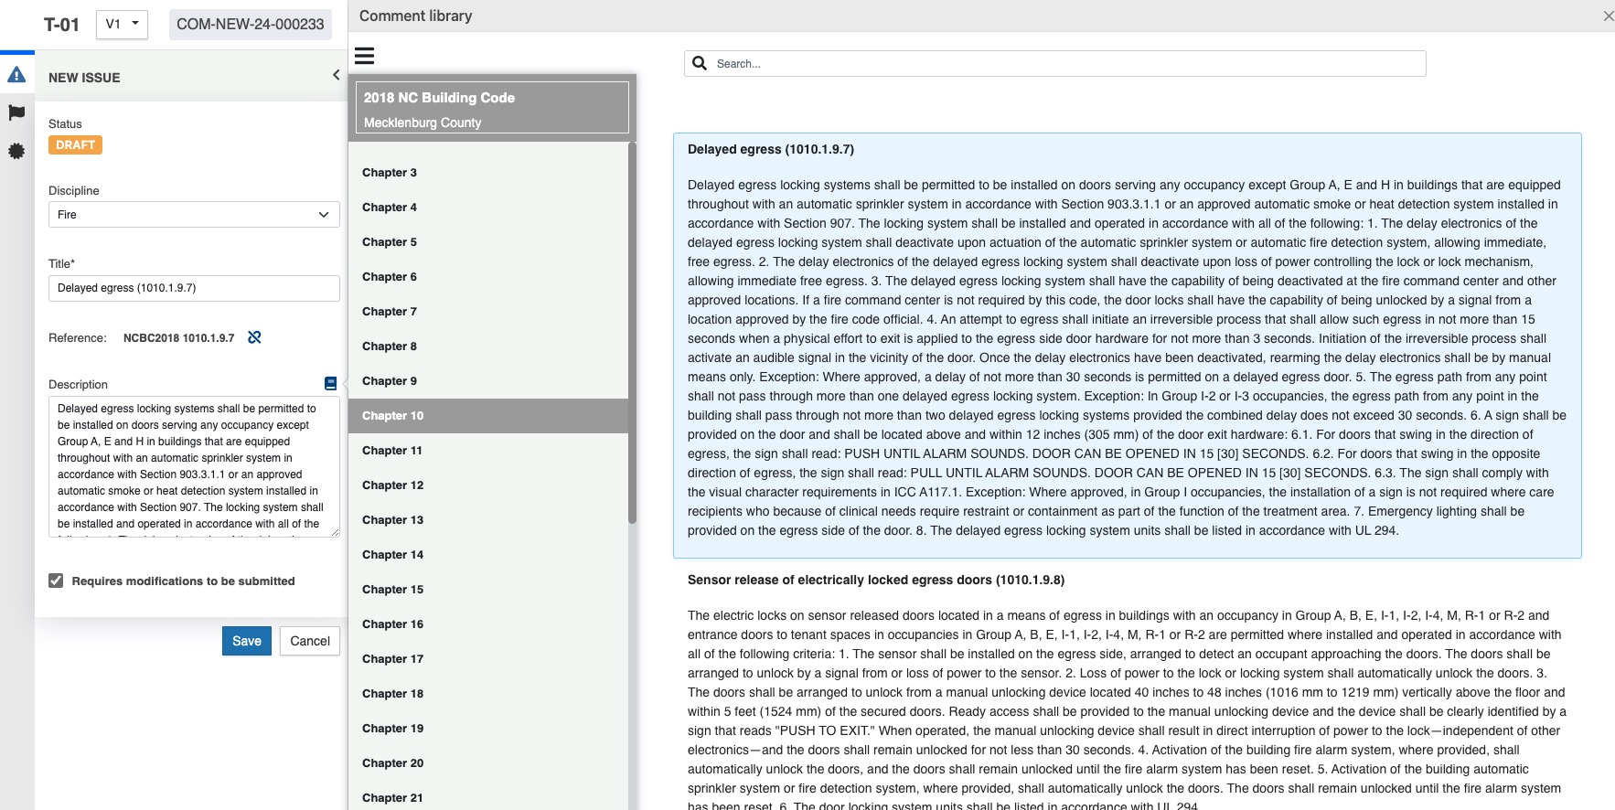
Comment Library

Slide 24
Questions

Slide 25
DPR File Type Roles
Role | File Type(s) Accepted | Viewable in DPR | Digital Signature Validation | File Processing | Sheet Versioning | Eligible for Issues/Conditions/Notes
Plan | PDF | Yes | Yes | Yes | Yes | Yes
Supporting Document | PDF | Yes | Yes | Yes | No | Yes
Attachment | Any file type allowable to be uploaded into iMS | No | No | No | No | No

Slide 26
Plan Room Tabs
Tab | Description
Summary | Snapshot of plan review progress; Summary of issues, conditions and notes
Review Packages | List of submittals from the customer; Each contains the files submitted
Plans | Plan sheets versioned at the sheet-level
Documents | Supporting documents listed for review
Attachments | Documents no reviewable for plan review can be downloaded
Issues | List of issues for the project
Conditions and Notes | List of conditions, notes and internal notes for the project
Approved | List of approved documents generated by DPR

Slide 27
Plan Room Project Statuses
Status | Description
Intake | Initial status for a project
Submitted | Status once customer has submitted a review package If a review package is ReOpened the project status changes back Intake
In Review | Status once the project is routed for review
Not Approved | Status if corrections are required for the project Once a customer resubmits, the status is updated to Submitted
Approved | Status of the project once it has been approved
Closed | Status of the project once it has been closed Closed projects do not show in the project list by default

