Slide 1
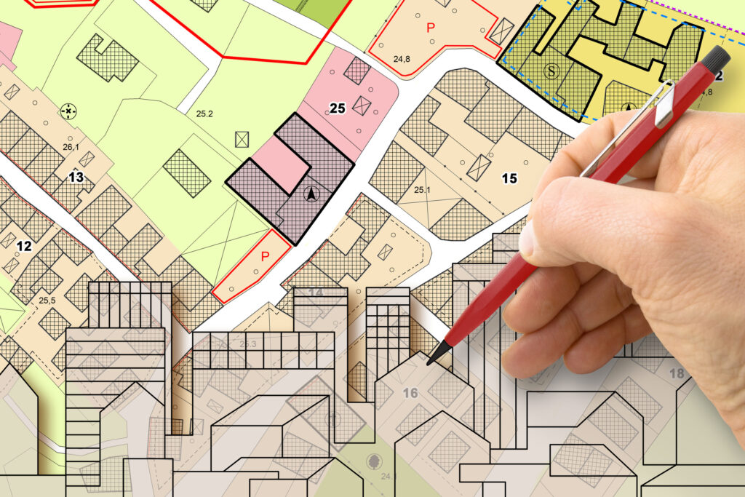
GROWTH MANAGEMENT DEPARTMENT
PROGRAMS & PROCESSES
JANUARY 2025
LISA FRAZIER, AICP
GROWTH MANAGEMENT DIRECTOR

Slide 2
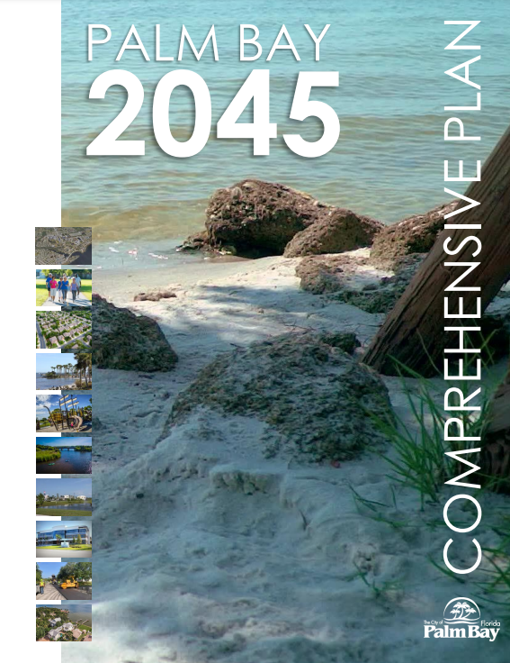
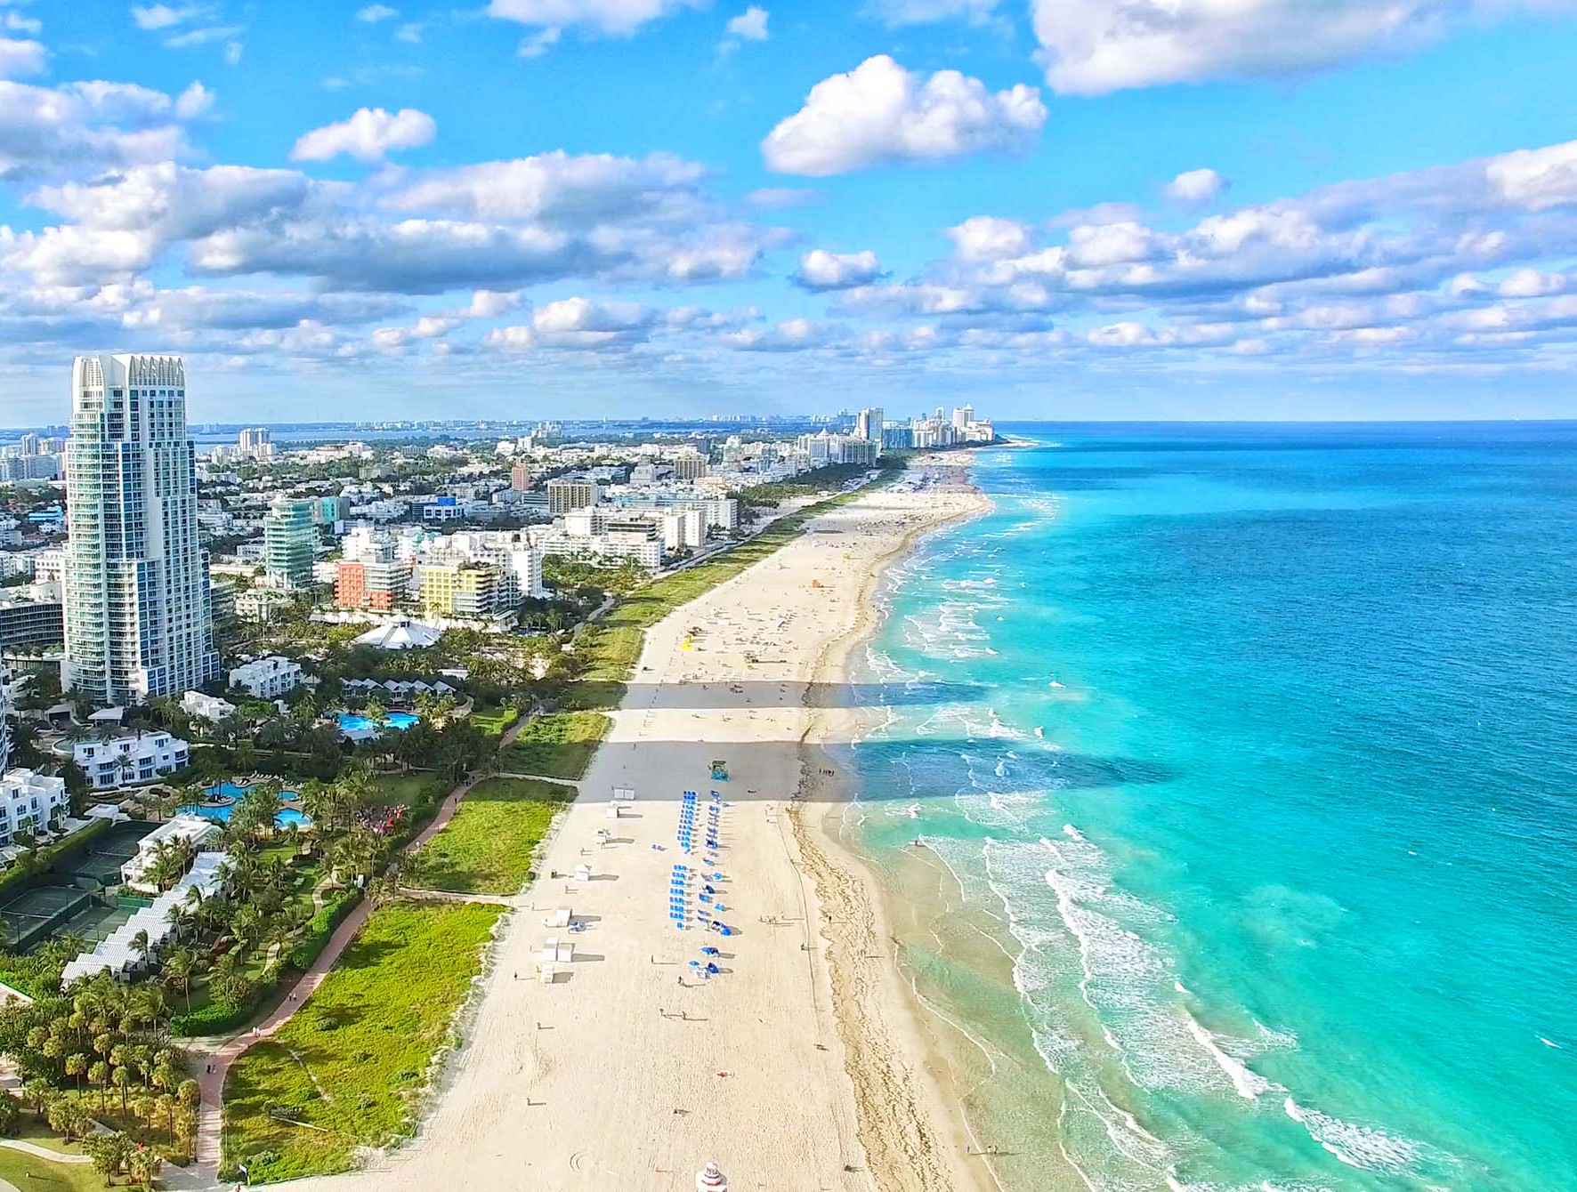
BACKGROUND
163.3202, F.S.
Land development regulations.
“Within 1 year after submission of its comprehensive plan … each municipality shall adopt or amend and enforce land development regulations that are consistent with and implement their adopted comprehensive plan.”
FLORIDA
STATUTES
2023

Slide 3
WORKING TOGETHER FOR THE
COMMUNITY!
MANAGEMENT
GM
POLICE
LEGAL
FIRE RESCUE
LEGISLATIVE
PARKS & FACILITIES
IT
PROCUREMENT
ECONOMIC DEVELOPMENT
ENGINEERING & PUBLIC WORKS
HUMAN RESOURCES
FINANCE
UTILITIES
BUILDING DEPT

Slide 5
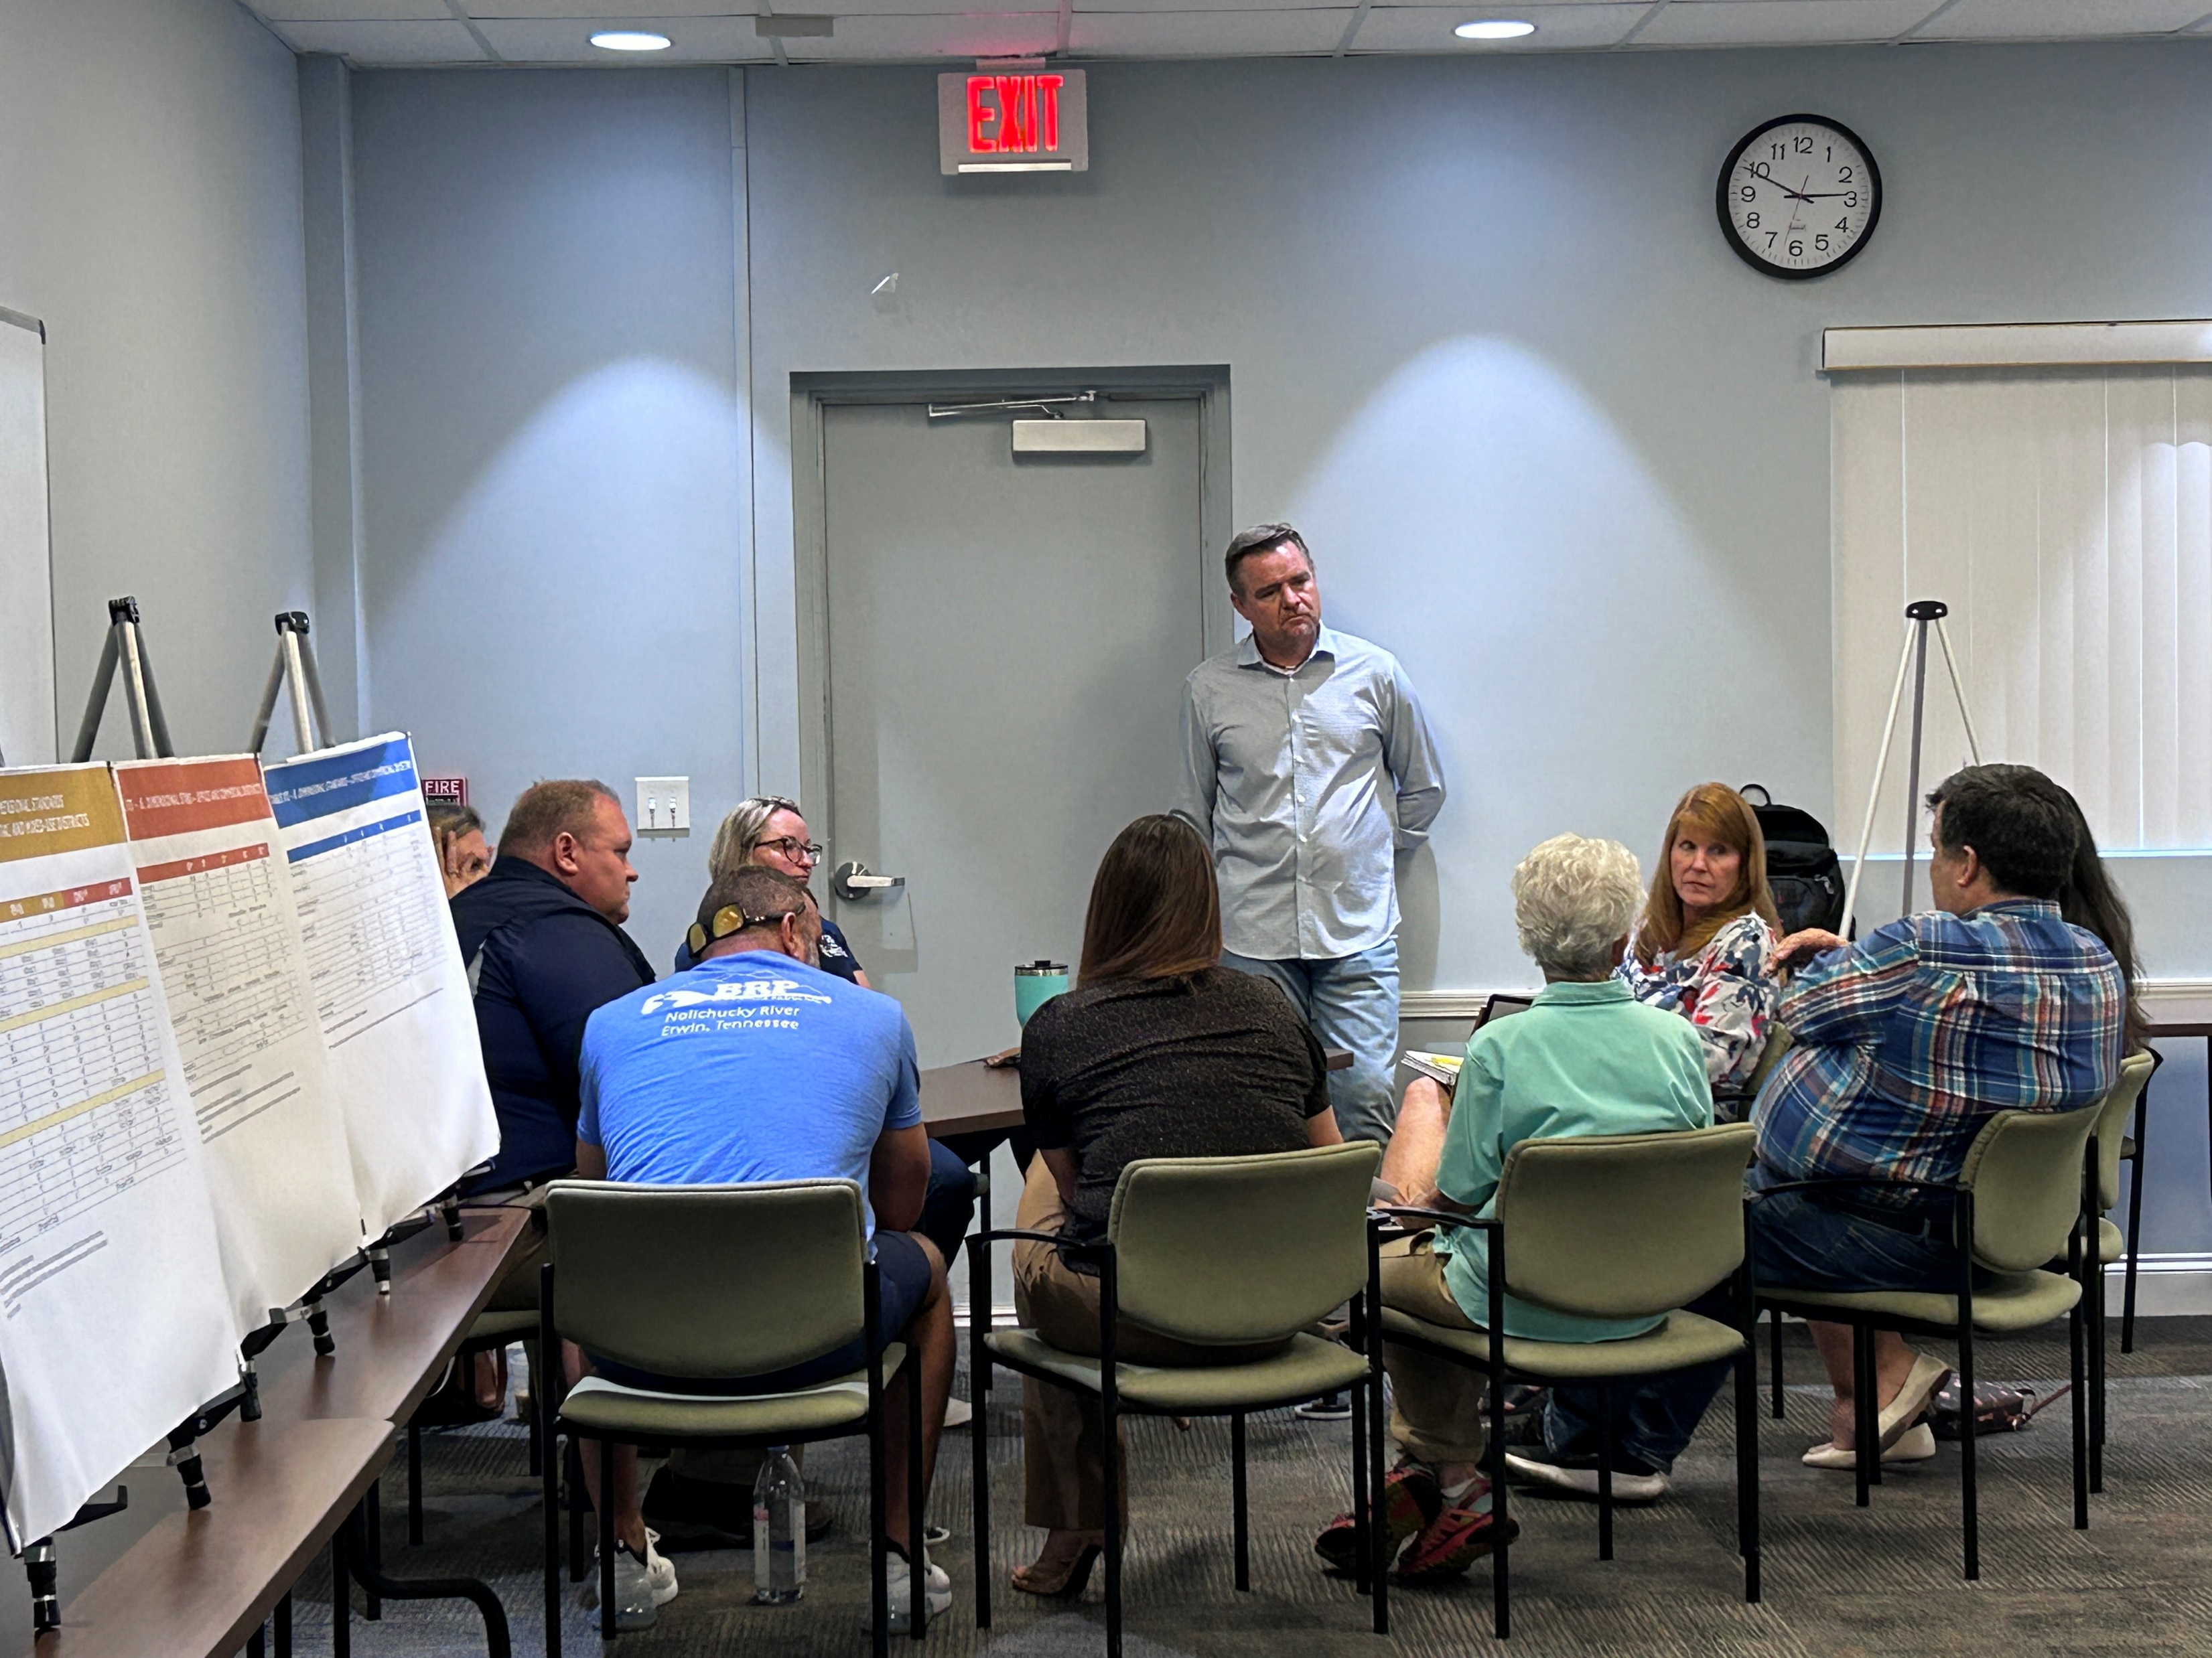
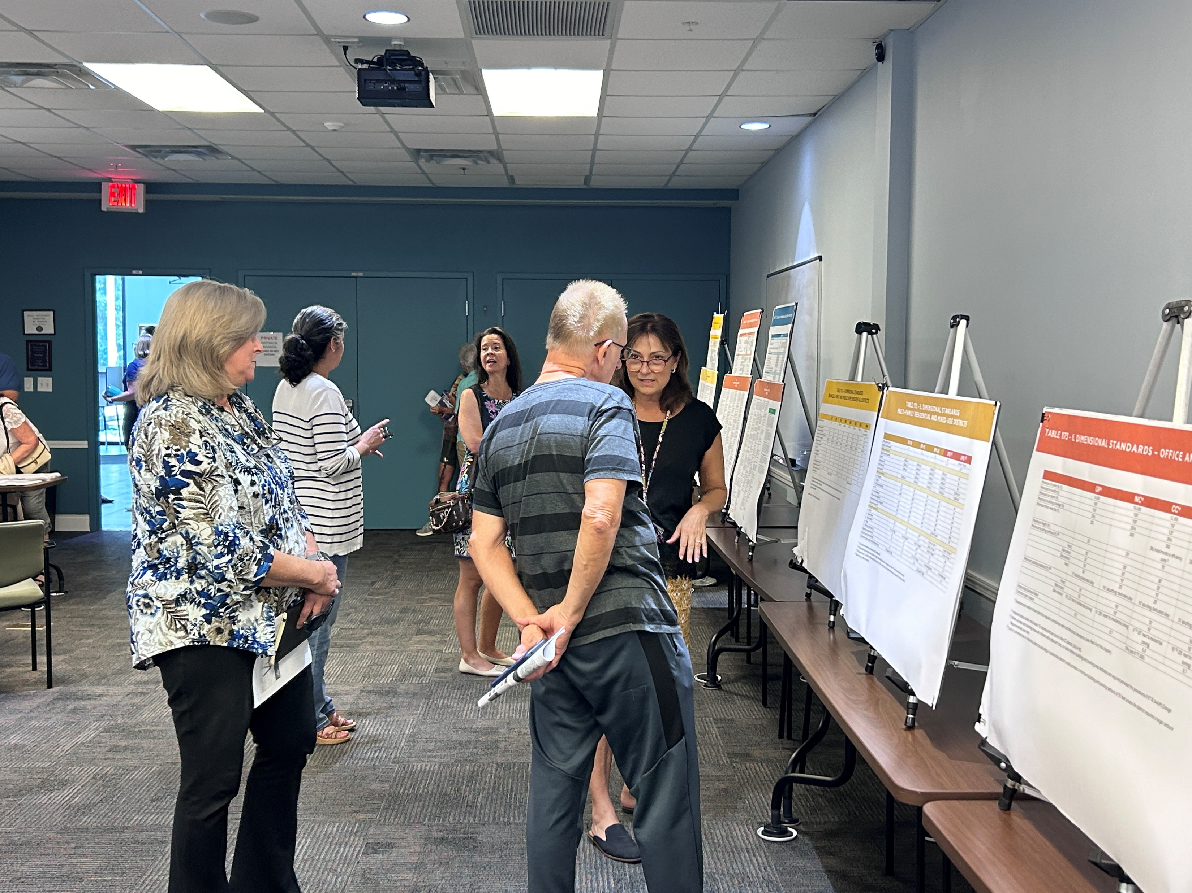
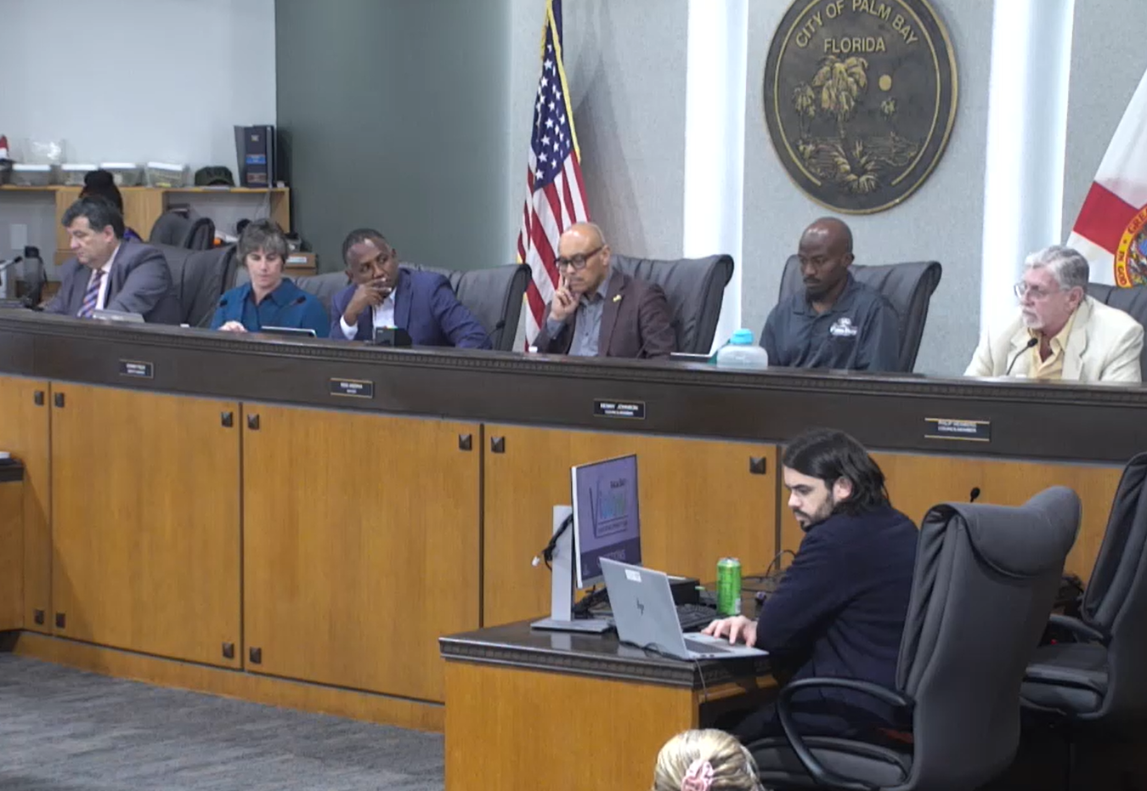
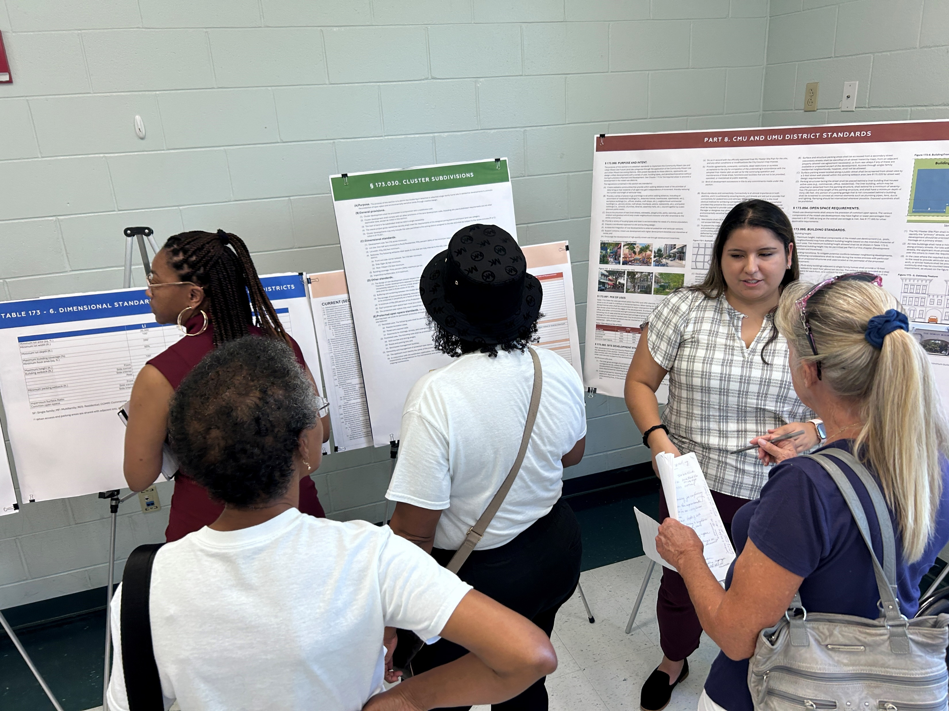
ADDITIONAL 2024 PUBLIC OUTREACH
3
meetings
54
attendees
PZB Hearing August 7
City Council Hearing August 8
Open House #1 August 15
Open House #2 August 16
Virtual Session August 19
City Council Adoption Hearing September 19
186
comments
Notes:
On Aug. 7, the Planning and Zoning Board voted to recommend approval of the LDC update.
On Aug. 8, the CC voted to table the first reading to August 29 to allow for additional meetings with the public.
Last time Pat mentioned that we had 3 additional meeting, 54 people participated, and we received 186 comments.
We created a matrix specifying which comments resulted in changes to the draft, which would be addressed in phase 2, and which changes staff did not agree with.
At the last hearing, on Aug. 29, staff brough up a few changes that needed CC input, and the CC requested additional changes based on input at the hearing. Those are the edits that we will cover in this presentation.

Slide 6
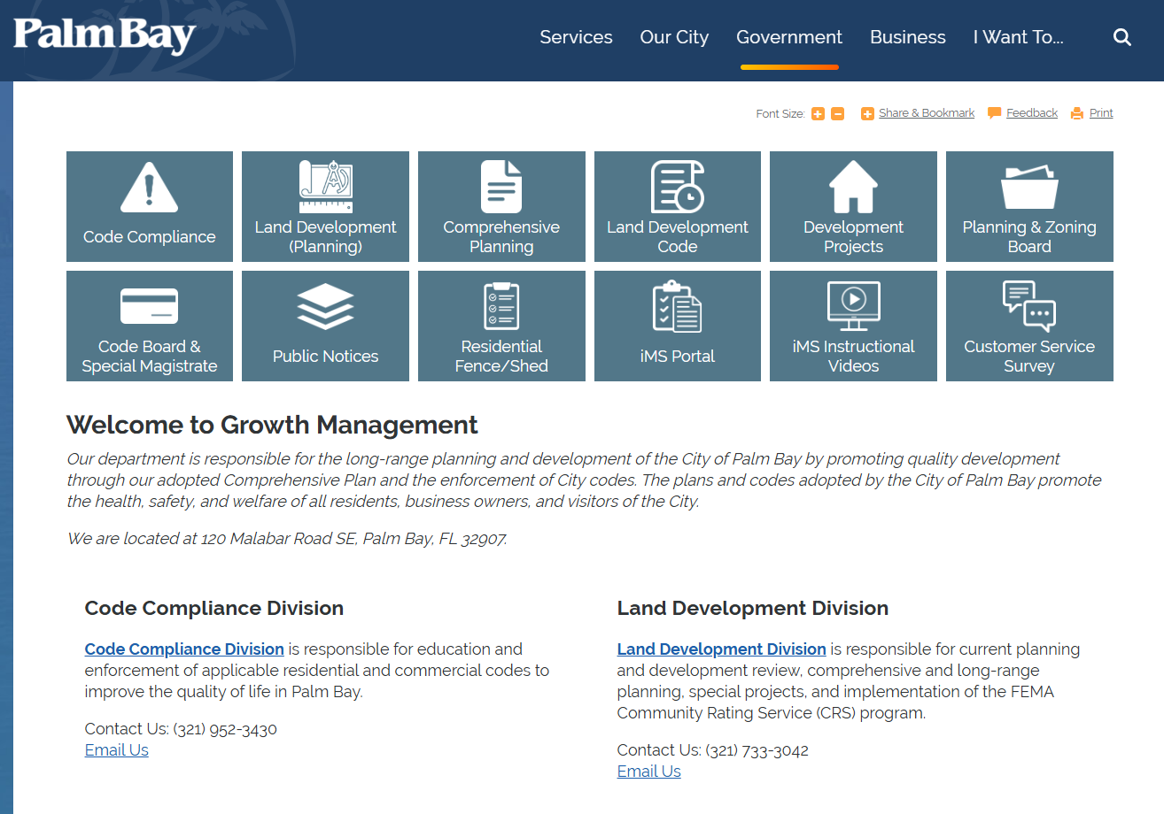
WHERE TO FIND THE NEW LDC
https://www.palmbayflorida.org/government/city-departments-f-to-z/growth-management

Slide 7
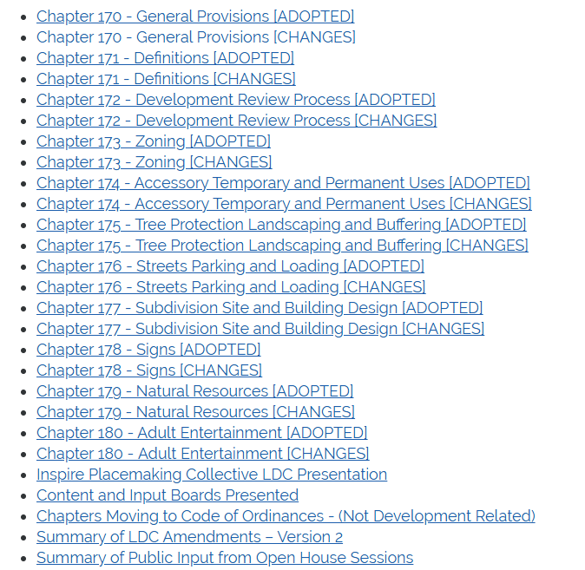
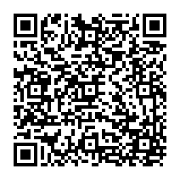
ADOPTED
SEPTEMBER 19, 2024
https://www.palmbayflorida.org/government/city-departments-f-to-z/growth-management/land-development-code-updates

Slide 8
MAJOR CHANGES
172
CHAPTER 172. DEVELOPMENT REVIEW PROCEDURES
Major Changes:
Created summary table of application types
Added sections explaining pre-application meetings, submittal of applications, staff review, and hearings.
Consolidated all appeal provisions into a single location
Added short section on annexation reviews
Updated section on comprehensive plan amendments
Clarified/added review procedures and criteria
Standards specific to certain uses moved to Ch. 174
Expanded Variance section (CAO)
Deleted section on Planned Industrial (not required)
Proposed new procedure to review mixed-use developments that meet code (no PUDs required)
Updated PUD procedures section (GM) and separated the RAC-PUD.
Updated Subdivision Code (GM)
Cleaned up Concurrency section
Contents:
Applicability
General Procedures (citizen participation plans, hearings, DRC, appeals, table of application types)
Application Types (annexations, plan amendments, rezones, LDC amendments, site plans, conditional uses, variances, master plans)
Zoning Amendment to PUD
Zoning Amendment to RAC-PUD
Subdivision Application and Approval Process
Vacating Plats & ROW
Concurrency Management System
Development Agreements
Proportionate Fair Share Transportation

Slide 9
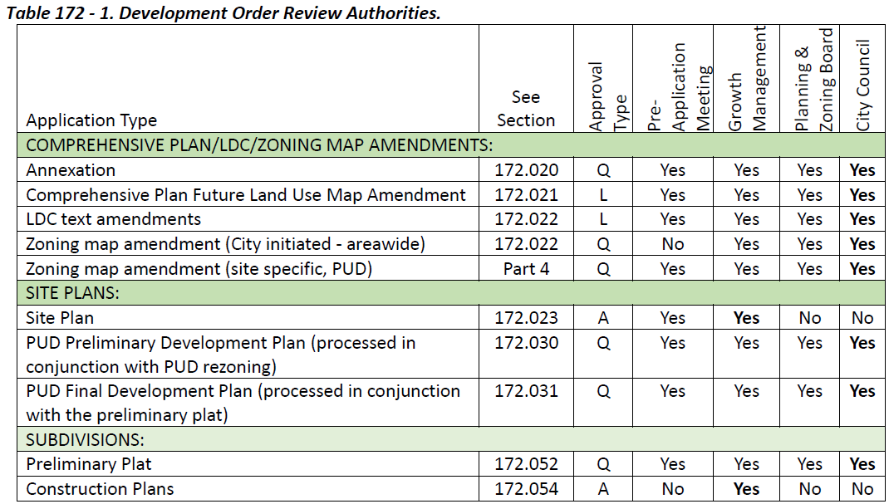
MAJOR CHANGES
172
DEVELOPMENT REVIEW PROCEDURES

Slide 10
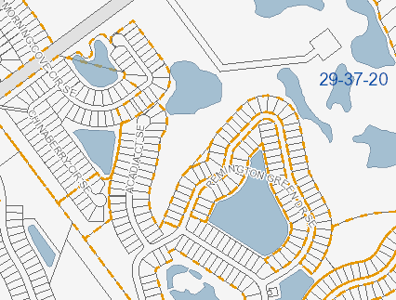
MAJOR CHANGES
172
Revised the Subdivision procedures section to:
Defined requirement for common open space, a minimum of 20% of a residential development or 10% of a non-residential development shall be dedicated to common open space.
Removed Minor Subdivision
Defined Lot Split and procedures
Added Site Work Permit
Restructured Preliminary Plat and Final Plat process to include time restrictions, approval process, required agreements
Removed construction restriction prior to Final Plat
Clarified Model Home Display Group/Early Starts in conformance with State Statute

Slide 11
MAJOR CHANGES
173
CHAPTER 173. ZONING
Contents:
PART 1. GENERAL PROVISIONS
Application
Zoning Districts Established
Zoning Map
PART 2. STANDARD ZONING DISTRICT REGULATIONS
Intent of Standard Zoning Districts
Schedule of Uses
Bulk and Dimensional Standards
PART 3. RESIDENTIAL DEVELOPMENT TYPES
Cluster Subdivisions (CU)
Multi-family
Townhomes
Manufactured Housing/Mobile Homes
Zero-Lot-Line Developments
PART 4. ARCHITECTURAL STANDARDS
PART 5. DEVELOPMENT BONUSES & INCENTIVES
PART 6. PUD ZONING DISTRICT REGULATIONS
PART 7. REGIONAL ACTIVITY CENTER (RAC) PUD
PART 8. CMU AND UMU DISTRICT STANDARDS
PART 9. NON-CONFORMANCE PROVISIONS
PART 10. VESTED RIGHTS

Slide 12
MAJOR CHANGES
173
Added a table to identify which zoning districts implement each Future Land Use category.
Moved standards for specific uses to another chapter.
Streamlined the intent of each district and moved uses and regulations to tables.
FUTURE LAND USE CATEGORY | ZONING DISTRICTS
RSF - Rural Single Family | GU – General Use Holding District
LDR – Low Density Residential | RR - Rural Residential | RS-1 - Single-Family Residential
 | RE - Estate Residential | RS-2 - Single-Family Residential
 | SRE - Suburban Residential Estate | RS-3 - Single-Family Residential
MDR - Moderate Density Residential | RT-10 - Residential Transition | RMH - Residential Mobile Home
HDR - High Density Residential | RM-15 – Multiple-Family Residential | RM-20 - Multiple-Family Residential
NC - Neighborhood Center | RT-10 – Residential Transition | RM-20 - Multiple-Family Residential
 | RM-15 - Multiple-Family Residential | NC - Neighborhood Commercial
 | OP - Office Professional
CMU - Community Mixed Use | CMU – Community Mixed Use
UMU - Urban Mixed-Use | UMU – Urban Mixed Use
PRO - Professional Office | OP - Office Professional
COM - Commercial | NC - Neighborhood Commercial | GC - General Commercial
 | CC - Community Commercial | HC - Highway Commercial
IND - Industrial | LI - Light Industrial & Warehousing | HI - Heavy Industrial
PSP - Public/Semi-Public | IU - Institutional
UTL - Utilities | IU - Institutional
ROS - Recreation & Open Space | IU - Institutional
CON - Conservation | C - Conservation
PFU - Parkway Flex Use | PUD – Planned Unit Development
SPA - Special Planning Area | PUD – Planned Unit Development
RAC - Regional Activity Center | PUD – Planned Unit Development

Slide 13
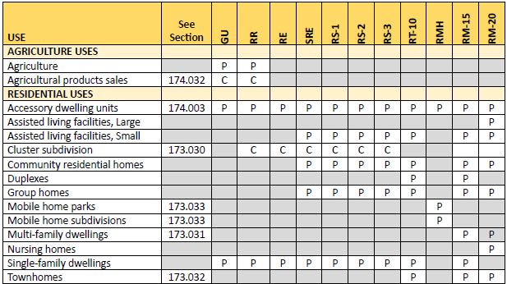
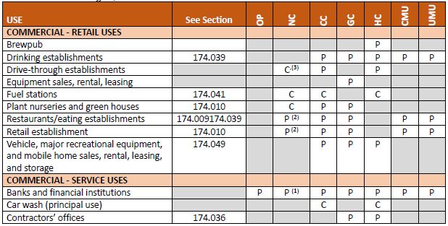
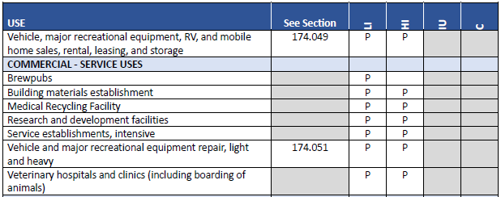
MAJOR CHANGES
173
Created a series of tables listing the uses that are allowed as permitted by right or through conditional use within each zoning district
Permitting small-scale office uses within residential FLU categories when properties are ill-suited for residential development
Consolidated RM-10 and RM-15 and all PUDs and eliminated SF-1, Restricted Commercial (RC) and Recreational Vehicle Park (RVP)
Added a new zoning district (RT-10) which permits moderate density residential development inclusive of missing middle housing

Slide 14
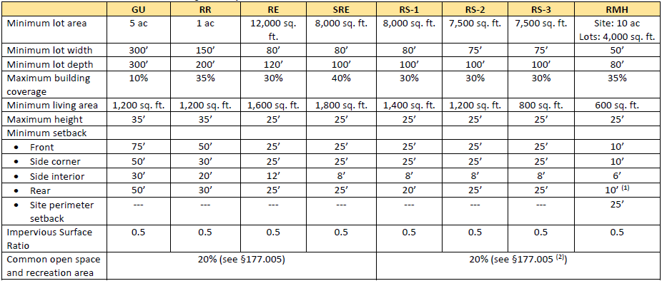
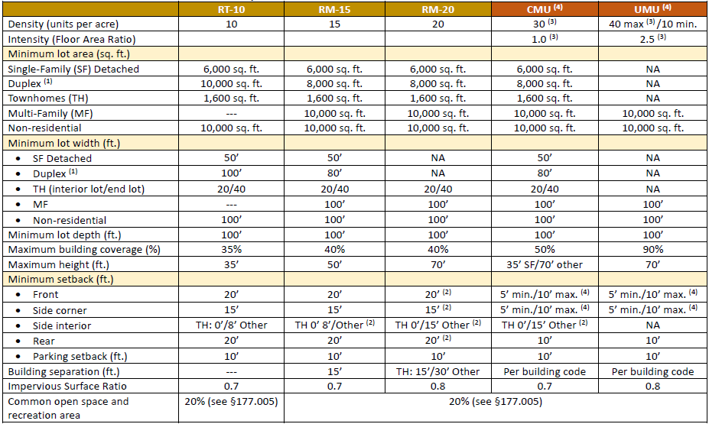
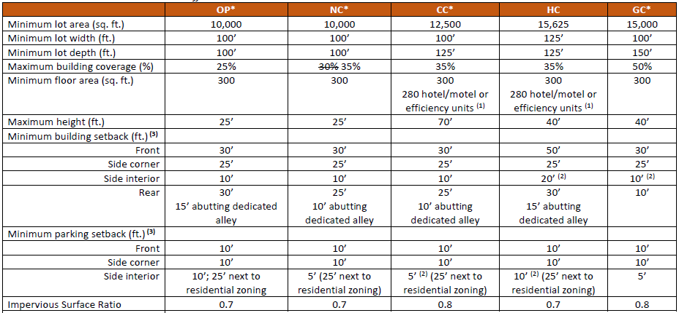
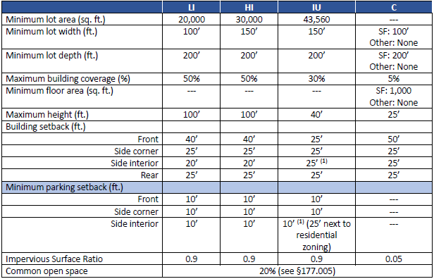
MAJOR CHANGES
173
Dimensional Standards Tables. Added tables listing development standards for each district
Added Impervious Surface Ratio requirement (0.5 to 0.9)
Added Recreation and Open Space requirement (20%-25%)
RS-1: Living Area reduced from 1,600 to 1,400
RM-15: Increased max. height from 25’ to 50’
RM-15 and RM-20: Reduced front setback from 25’ to 20’; side corner setback from 25’ to 15’; and rear setback from 25’ to 20’.
NC: Increased max. building coverage from 30% to 35%.

Slide 15
MAJOR CHANGES
173
Revised the PUD procedures (Ch. 172) and standards (Ch. 173) sections to:
Consolidated PCD, PCRD, and PMU under PUD umbrella zoning
Added Activity Based and Resource Based Open Space
PUD/Preliminary Development Plan zoning amendment, and Development Agreement process
Final Development Plan/Preliminary Plat process
Clarified 20% non-residential, 25% open space
Restructured to highlight infill development and lot sizes
Restructured to highlight concurrency management and review criteria
Clarified PFS and Performance Bonds

Slide 16
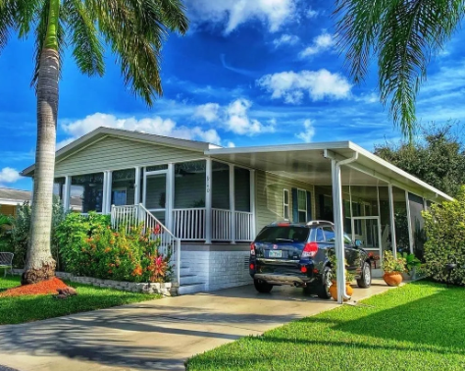
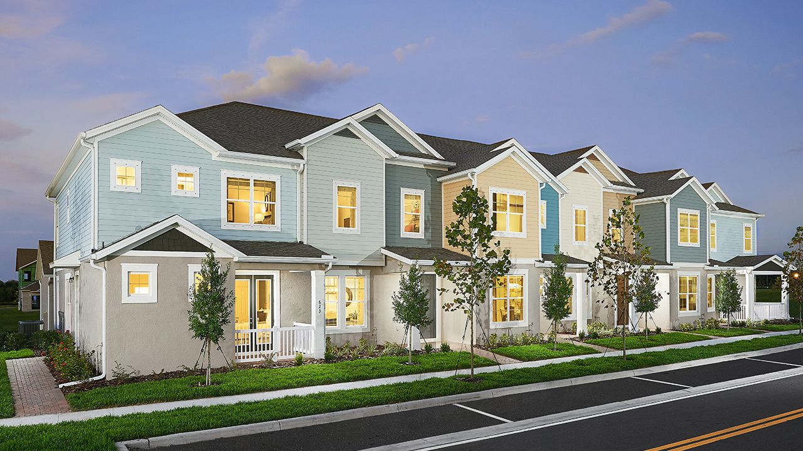
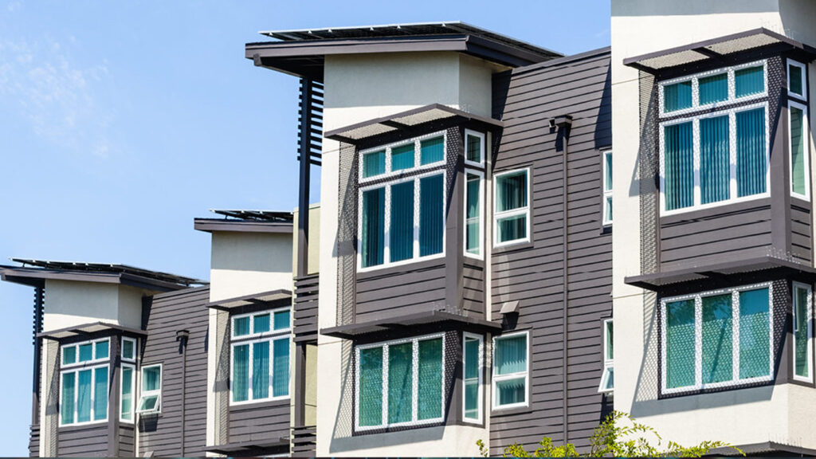
MAJOR CHANGES
173
Consolidated/establish standards for specific development types:
Cluster subdivisions
Townhomes
Multi-family
Manufactured/mobile homes
Zero-lot-line developments
Cleaned up the architectural standards

Slide 17
MAJOR CHANGES
173
Created standards for the new Community Mixed-Use and Urban Mixed-Use Districts:
Implement Future Land Use categories.
Process through Master Plan approval based on pre-set standards
Intended to create integrated mixed-use communities

Slide 18
MAJOR CHANGES
173
Proposed feature | Density Bonus | Intensity Bonus | Building Height | Other | Conditions
Vertical mixed-use (residential and commercial or office) |  |  | 2 stories |  | Minimum of 5 residential units provided
Affordable housing | Max allowed in FLU category |  | 2 stories |  | A minimum of 25% of total units in development shall be affordable. Developers’ agreement committing to keeping the units affordable for a minimum of 30 years.
Public Open Space and Amenities | 2 additional units per acre for every 3,000 sq. ft. of amenities | 0.02 additional FAR for every 3,000 sq. ft. of amenities | 1 story for every 3,000 sq. ft. of amenities |  | Urban plaza or park with amenities, at least three thousand (3,000) square feet in area or multi-use trails connecting to other systems outside the development. The amenities shall be privately-owned and maintained, but open to the public
Parking garage under residential, office or commercial development |  |  | 1 additional floor per garage level provided |  | The façade facing the street shall incorporate active uses (residential, commercial or office)
Access to Waterfront (Turkey Creek, Palm Bay, and the Indian River Lagoon) |  |  | 1 additional floor |  | One or combination of the following: 1. View of the water from the public right-of-way (in the form of breezeways); 2. Access to the water in the form of boat ramps, fishing piers, or beach; 3. Outdoor dining facing the water.
Low Impact Design | 2 additional units per acre | 0.02 additional FAR |  |  | Designs shall, at a minimum, manage and capture stormwater runoff, to the maximum extent feasible, in a manner consistent with the integrated management practices (IMPs) as outlined in the City's Low Impact Development Manual.
Emergency storm shelters in mobile home or RV parks | 2 additional units per acre |  |  |  | shelters which meet the design and construction requirements established within the latest “ICC 500 ICC/NSSA Standard for the Design and Construction of Storm Shelters”
Use of living shoreline techniques to prevent shoreline erosion |  |  |  | Reduced parking (up to 10% of the minimum number of spaces required) | One or more techniques
Co-location of water-dependent and water-related uses |  |  |  | Reduced parking (up to 10% of the minimum number of spaces required) | Minimum of 2 water-dependent uses; or 1 water-dependent and 1 water-related uses. Uses must be located within the same structure or provide cross access via a shared pedestrian pathway.

Slide 19
REVIEW TIMELINE
General timeline for submittal to P&Z and Council
5 Business days
30 Business Days
Repeat up to 3X
P&Z
CC
Step 1: Submittal of application through iMS portal
Step 2: Comments from City Staff
Step 3: Distribution for comments among City staff
Step 4: Planning and Zoning Board Meeting
Step 5: City Council 2x
Within 5 business days, City staff will distribute application to DRC if complete or notify the applicant if any items are missing. The application will not be distributed to DRC for review if not complete.
City Staff will respond with comments within 30 days for each subsequent submittal by applicant until complete in accordance with Florida Statute 166.033.
Process may repeat 3x for subsequent submission and distribution to city staff.
A meeting will be required with applicant and DRC if not complete by 3rd submission.
Once the Package is complete and in compliance, City Staff will schedule for the next available PZ Board meeting in accordance with public noticing requirements
City Staff will schedule for the next available City Council meeting in accordance with public noticing requirements. CC will consider all conditions of approval by Ordinance (2 public hearings)

Slide 20
PUBLIC NOTICE TIMELINE
Before a case may be heard before the P&Z Board, the following public notices must occur:
22 days before – Meeting Notices Mailed
10 days before – Legal Ad Published (different requirements for some applications)
10 days before – CPP Signs Posted
7 days before – Meeting Packet Posted

Slide 21
Timeline for PUD/Preliminary Development Plans and PUD Agreement
Timeline for PUD/PDP and PUD Agreement submittal to P&Z and Council
5 Business days
30 Days
Repeat up to 3X
P&Z
CC
Step 1: Submit the PDP to Land Development Department
Step 2: Comments from City Staff
Step 3: Distribution for comments among City staff
Step 4: Planning and Zoning Board Meeting
Step 5: City Council 2X
Within 5 business days, City staff will distribute application to DRC if complete or notify the applicant if any items are missing. The application will not be distributed to DRC for review if not complete.
City Staff will respond with comments within 30 days for each subsequent submittal by applicant until complete in accordance with Florida Statute 166.033.
Process may repeat 3x for subsequent submission and distribution to city staff.
A meeting will be required with applicant and DRC if not complete by 3rd submission.
Once the Package is complete and in compliance with PUD Zoning, City Staff will schedule for the next available P&Z Board meeting in accordance with public noticing requirements
City Staff will schedule for the next available City Council meeting in accordance with public noticing requirements. CC will consider all conditions of approval by Ordinance (2 public hearings). City Clerk to record.

Slide 22
Timeline for Final Development Plans and DA
Timeline for FDP submittal to P&Z and Council
5 Business days
30 Days
Repeat up to 3X
P&Z
CC
Step 1: Submit the FDP to Land Development Department
Step 2: Comments from City Staff
Step 3: Distribution for comments among City staff
Step 4: Planning and Zoning Board Meeting
Step 5: City Council
Within 5 business days, City staff will distribute application to DRC if complete or notify the applicant if any items are missing. The application will not be distributed to DRC for review if not complete.
City Staff will respond with comments within 30 days for each subsequent submittal by applicant until complete in accordance with Florida Statute 166.033.
Process may repeat 3x for subsequent submission and distribution to city staff.
A meeting will be required with applicant and DRC if not complete by 3rd submission.
Once the Package is complete and in compliance with PUD Zoning and PDP, City Staff will schedule for the next available PZ Board meeting in accordance with public noticing requirements
City Staff will schedule for the next available City Council meeting in accordance with public noticing requirements. CC will consider all conditions of approval by Resolution

Slide 23
Timeline for Preliminary Plat
Timeline for submittal to P&Z and Council
5 Business days
30 Days
P&Z Board
CC
Submission of Final Plat and Construction Plans
Step 1: Submit the Prelim Plat Application to Land Development Department
Step 2: Comments from Staffs
Step 3: Planning and Zoning Board Meeting
Step 4: City Council Meeting
Step 5: Applicant will submit for Final Plat and Construction Plan Review
Within 5 business days, City staff will distribute application to DRC if complete or notify the applicant if any items are missing. The application will not be distributed to DRC for review if not complete.
City Staff will respond with comments within 30 days for each subsequent submittal by applicant until complete in accordance with Florida Statute 166.033.
Once the Package is complete and in compliance, City Staff will schedule for the next available P&Z Board meeting in accordance with public noticing requirements
City Staff will schedule for the next available City Council meeting in accordance with public noticing requirements. CC will consider all conditions of approval by Resolution
Following preliminary plat approval, applicant will submit for Final Plat and/or Construction Plan Review.

Slide 24
Timeline for Final Plat
Timeline for submittal to Council
5 Business days
30 Days
CC
Final Approval
Step 1: Submit the Final Plat Application to Land Development Department
Step 2: Comments from City Staff
Step 3:
Step 4: City Council
Step 5: Final Approval
Within 5 business days, City staff will distribute application to DRC if complete or notify the applicant if any items are missing. The application will not be distributed to DRC for review if not complete.
City Staff will respond with comments within 30 days for each subsequent submittal by applicant until complete in accordance with Florida Statute 166.033.
Final Plats will no longer be reviewed by the P&Z Board
Once the Package is complete and in compliance with Preliminary Plat and Construction Drawings, City Staff will schedule for the next available CC meeting in accordance with public noticing requirements. CC will consider all conditions of approval by Resolution
Mylar to be delivered to City Surveyor and City Clerk for final signatures. City Clerk to record.

Slide 25
COMING SOON: PHASE II CHANGES
CHAPTER 172: DEVELOPMENT REVIEW
172 | Review all application requirements
172 | Table 172-1 - Development agreement incorrect in table - it does not go to PNZ, only to council per code section
172.010 | Requirements for concept plan needs to be added (guidebook, pg 5)
172.010 | Add Development Order language to staff review (per 172.001)
172.010 (C)(2) | Review completeness check language to include 90 days to achieve - or file will be closed & applicant must resubmit
172.011 | Add Cost Recovery Provisions to "schedule of fees and charges"
172.011 | Beef up the schedule of fees and charges (See example in folder)
172.012 (C)(2)(a) | add distance location requirements for CPP meeting venue
 | Increase CPP distance requirements From 500 to 1,200?
172.012(B)(2) | Should we clarify that preliminary and final plats do not need another CPP if they are part of a PUD that already had one?
172.022(E) | Needs stronger locational criteria for amendments/rezonings
172.023 | Add site plan submittal requirements
172.024 | Specify site plan approval expiration
172.027(B)(1)(b) | Revise concurrency requirement to specify "analysis" is needed (review this for all application submittals)
172.030(I) | Section 172.031(D)(5) references Section 172.030(I), which does not exist.
172.082 | Include Annexations and Large-Scale Comprehensive Plan Amendments and change request to submit - The applicant shall request a concurrency evaluation during the PUD Final Development Plan, Site Plan, Final Plat, or building permit process.

Slide 26
COMING SOON: PHASE II CHANGES
CHAPTER 172: DEVELOPMENT REVIEW, CONTINUED
172.012 | add "boundary line" (C)(2)(a)
172.024 (G) | add "Site Plan Approval"
 | Part 4: add cross ref to 173, Part 6 PUD and Part 7, (RAC) PUD
172.030(B) | add "shall" and standards set forth in Ch. 173.061."
172.030(B) (2) | remove #10; add #11 "factors of" and reference 172.022(E)
 | move #16 to 172.031(A); change exhibit #16 to Trip Generation Letter
 | remove "exceptional" from #13
 | Change #19 to PUD Agreement (Definition?)
172.030(D)(3) | Change all reference from DA to PUD Agreement. Strike out last five lines
172.030(E) | change all references from DA to PUD
172.031(A) | remove repeat words "in addition"
 | (8) add: "per FS 163.3233"
172.031(D)(5) | (D) (5) change (I) to (G)
172.021 | Add Comp Plan Exhibits/submittals??

Slide 27
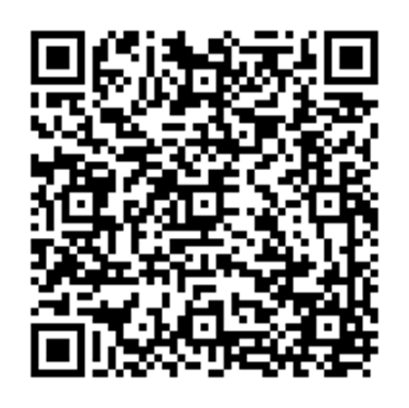
THANK YOU !
LISA FRAZIER, AICP
GROWTH MANAGEMENT DIRECTOR

