Slide 1

Quarterly Orientation for New Board Members
February 24, 2022

Slide 2
Orientation Overview
Welcome and Introductions
About Our City
City Organizational Structure
Equipping You for Success
Questions/Suggestions

Slide 3

Welcome and Introductions
Purpose
City Council and staff members
Introductions
  Name and how long you have been a resident
  Which board(s) you serve on
  Why you chose to serve and name one thing you love about Palm Bay!
You are….
  City Ambassadors
  Critical to our success

Slide 4
About Our City
Incorporated in 1960
Population 120,000+
88 square miles
40% built out
Largely a General Development Corporation (GDC) community
Surrounded by natural treasures: Turkey Creek/Sanctuary and Indian River Lagoon and Three Forks Conservation Area /St. Johns River
Growth Period
  Moving beyond single family housing
  Infrastructure needs and expanded services

Slide 5
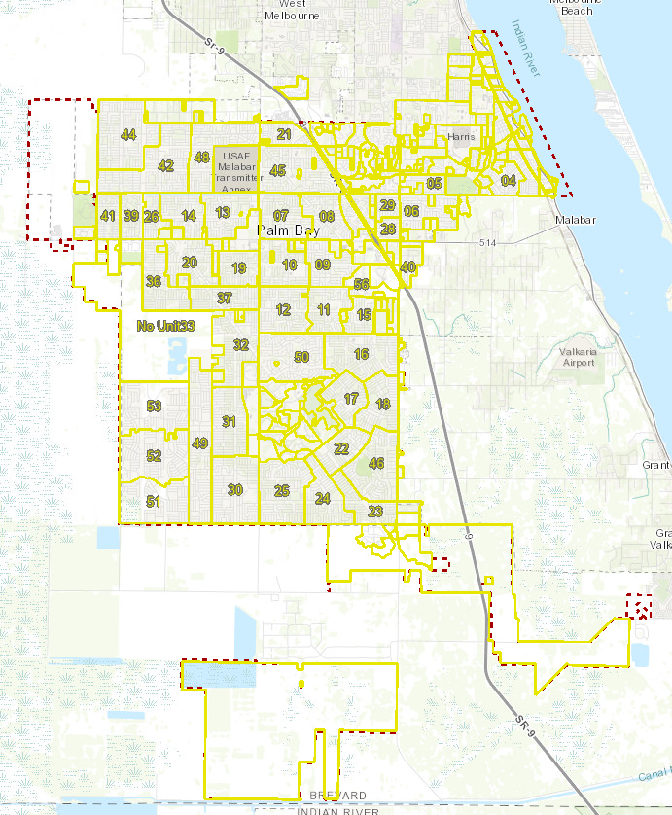

Slide 6
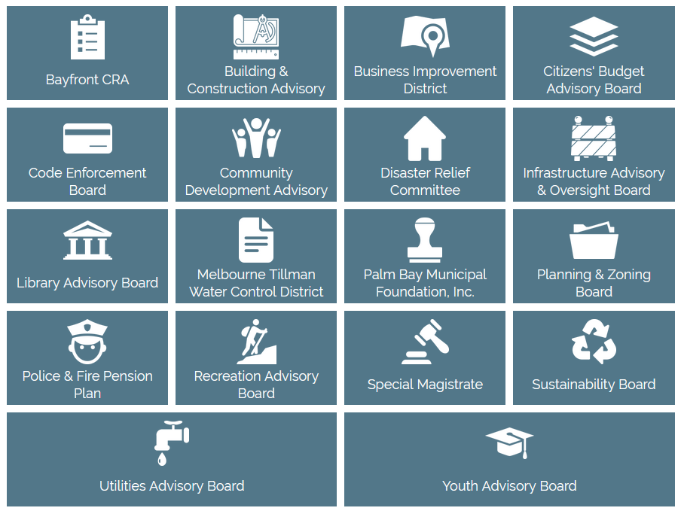

Slide 7
City Organizational Structure
Charter Officers: City Clerk, City Attorney, City Manager
City Departments (13):
Building
Community & Economic Development
Parks & Facilities
Finance
Fire
Growth Management
Human Resources
Information Technology
Recreation
Procurement
Police
Public Works
Utilities

Slide 8
Equipping You for Success
City Attorney’s Office
  Foundations for success - Ethics and Sunshine Laws
City Clerk’s Office
  Know your by-laws
  Understand City ordinances that relate to your board
  Meeting process/procedure questions
  Board member terms – processes for reapplying/reappointment
City Manager and Department Heads
  Resources for topics/information
  Website information
  Tours and meetings with appropriate staff to provide information/education

Slide 9
Equipping You for Success
Ideas and suggestions?
Other needs?
Contact us anytime!
Who to call:
Board Liaisons - contact City Manager/City Clerk if you are unsure
Terese Jones, City Clerk, 321-952-3414
Patricia Smith, City Attorney, 321-409-7185
Suzanne Sherman, City Manager, 321-952-3411

Slide 10
Thank you!
Suzanne Sherman, City Manager
citymanager@palmbayflorida.org
321-952-3411

