Slide 1
City of Palm Bay Vulnerability Assessment December 5, 2023

Slide 2
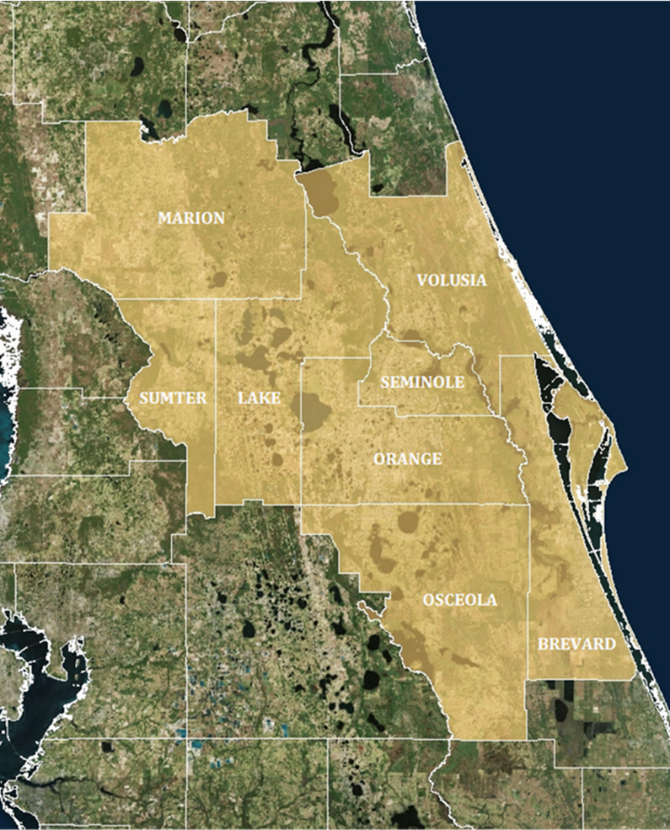
INTRODUCTIONS
About ECFRPC
One of Florida’s 10 Regional Planning Councils
Provide Technical Assistance to Governments and Organizations within Eight Counties
This Includes Developing Resiliency Analyses and Adaptation Plans

Slide 3
RESILIENCY FRAMEWORK
What is Resiliency?
The Ability to Bounce Forward; Absorb, Recover and Get Better in the Face of Short Term Shocks and Chronic Stressors.

Slide 4
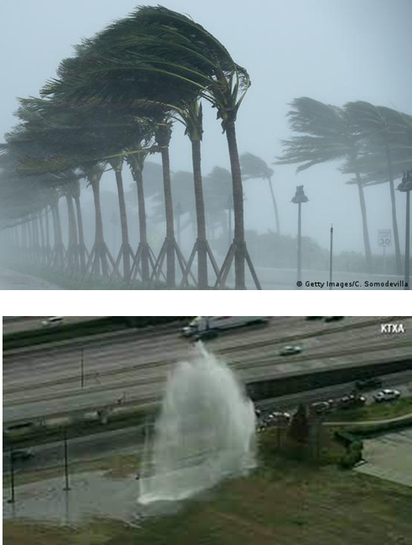
RESILIENCY FRAMEWORK
Acute Shock
Sudden, Sharp Natural or Man-Made Event that Threatens the Immediate Well-Being of a Community
Natural Disasters
Infrastructure Failure

Slide 5
RESILIENCY FRAMEWORK
Chronic Stressor
Continuous or Re-occurring Issues or Events that Impact or Weaken the Fabric of a Community on a Day to Day or Cyclical Basis

Slide 6
RESILIENCY FRAMEWORK
Shock and Stressors Relationship
A One-time Shock can Sometimes Exacerbate Community Stressors and/or Uncover Vulnerabilities

Slide 7
RESILIENCY FRAMEWORK
Vulnerabilities
Degree to Which a System, or Part of It, May React Adversely During The Occurrence of a Hazardous Event.
Identifying and Addressing Vulnerabilities can Help to Make a Community More Resilient to Shocks and Stressors

Slide 8
RESILIENT FLORIDA PROGRAM
F.S. Section 380.093
State is Particularly Vulnerable to Adverse Impacts from Flooding Resulting from Increases in Frequency and Duration of Rainfall Events, Storm Surge from More Frequent and Severe Weather Systems, and Sea Level Rise.
Such Adverse Impacts Pose Economic, Social, Environmental, and Public Health and Safety Challenges.
To Address These Challenges, Funding Should be Allocated in a Manner that Prioritizes Addressing the Most Significant Risks.

Slide 9
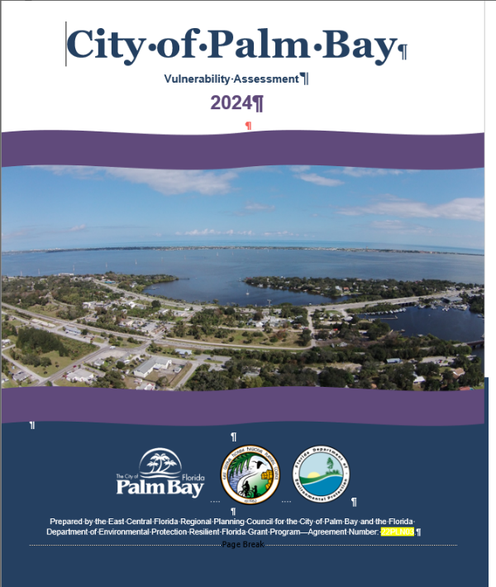
RESILIENT FLORIDA PROGRAM
Vulnerability Assessment Components
Critical Asset Inventory and Data
Exposure Analysis
Sensitivity Analysis
Public Engagement
Report, Maps, and Tables

Slide 10
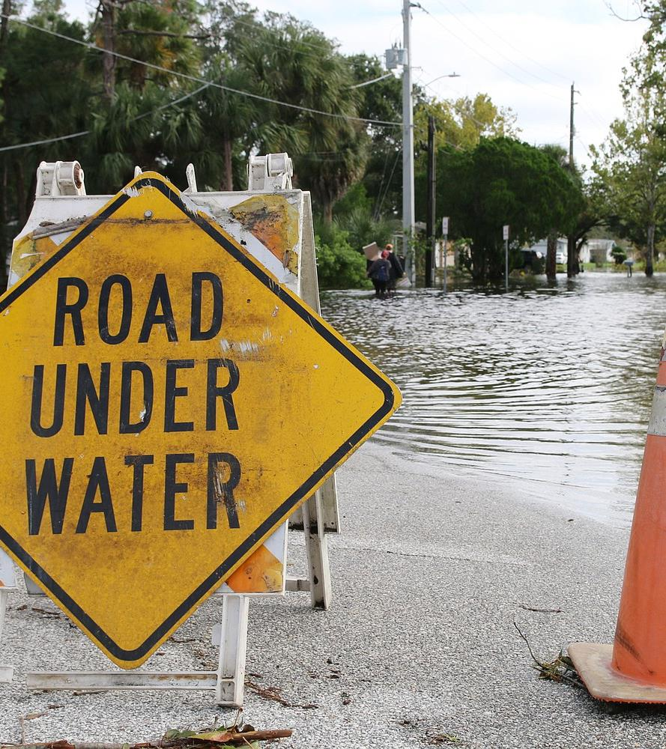
Critical Assets/Data
The Project Team, in Coordination with the Local Government, Should Research and Compile Data Needed to Perform The VA, Including: (1) Critical/Regionally Significant Assets; (2) Topographic Data; and (3) Flood Scenario-related Data.
Notes:
This vulnerability assessment includes: an inventory of critical assets (including regionally significant assets) that are essential for critical government and business functions; national security; public health and safety; the economy; flood and storm protection; water quality management; and wildlife habitat management—as well as the vulnerability and risk to each asset.

Slide 11
ASSESSMENT COMPONENTS
Critical Assets Inventory
Transportation Assets and Evacuation Routes: Airports, Bridges, Bus Terminals, Ports, Major Roadways, Marinas, Rail Facilities, and Railroad Bridges
Critical Infrastructure: Wastewater Treatment Facilities and Lift Stations, Stormwater Treatment Facilities and Pump Stations, Drinking Water Facilities, Water Utility Conveyance Systems, Electric Production and Supply Facilities, Solid and Hazardous Waste Facilities, Military Installations, Communications Facilities, and Disaster Debris Management Sites

Slide 12
ASSESSMENT COMPONENTS
Critical Assets Inventory
Critical Community And Emergency Facilities: Schools, Colleges, Universities, Community Centers, Correctional Facilities, Disaster Recovery Centers, Emergency Medical Service Facilities, Emergency Operation Centers, Fire Stations, Health Care Facilities, Hospitals, Law Enforcement Facilities, Local Government Facilities, Logistical Staging Areas, Affordable Public Housing, Risk Shelter Inventory, and State Government Facilities
Natural, Cultural, And Historical Resources: Conservation Lands, Parks, Shorelines, Surface Waters, Wetlands, and Historical and Cultural Assets

Slide 13
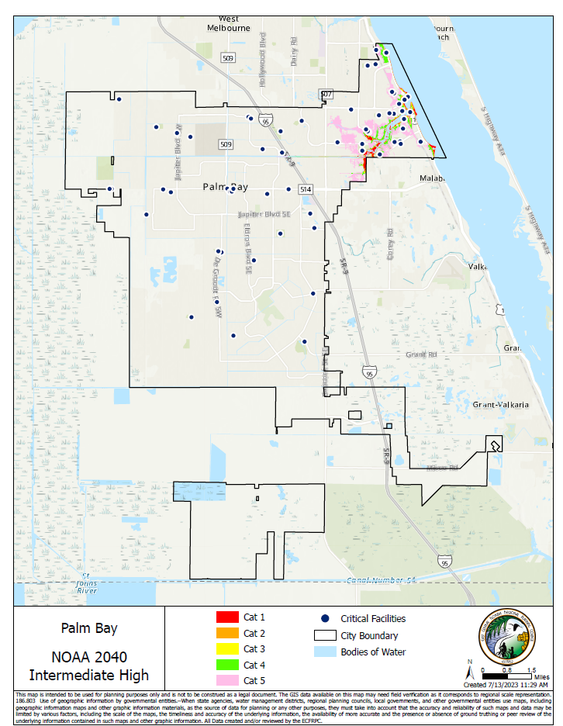
Exposure Analysis:
Identifies Baseline Risk and Allows a Community to Understand Those Risks in Terms of Spatial Extent and Level of Exposure.

Slide 14
ASSESSMENT COMPONENTS
Exposure Analysis
Two Planning Horizons
2040
2070
NOAA SLR Projections
Intermediate-Low (2017)
Intermediate-High (2017)
Storm Surge
Equal or Exceed the Current 100-year Flood Event

Slide 15
ASSESSMENT COMPONENTS
Exposure Analysis
Rainfall-induced Flooding (FEMA)
100-year storm
500-year storm
Tidal Days
Depth
Number of Tidal Flood Days
What’s Next?
Economic Corridors Exposure Analysis

Slide 16
EXPOSURE ANALYSIS
NOAA Sea Level Rise Projections
Intermediate Low
1.75 ft.
Minimum by 2100 (2017 NOAA)
Intermediate High
6.08 ft.
Minimum by 2100 (2017 NOAA)
Notes:
According to the 2022 Global and Regional Sea Level Rise Scenarios for the United States technical report by NOAA, the range includes a minimum rise of 1.75 (0.5m) feet by 2100 with an upper range of 6.08 (1.85m) feet by 2100 for the Contiguous United States.

Slide 17
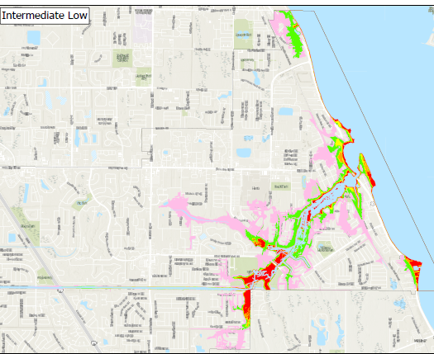
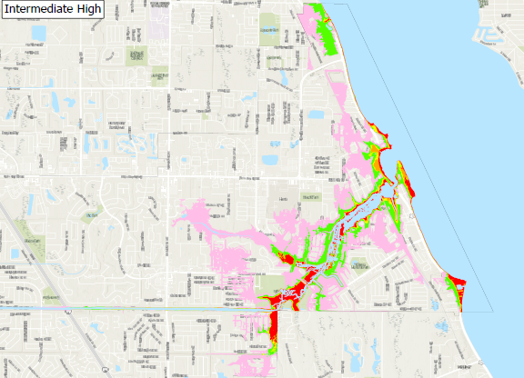
EXPOSURE ANALYSIS
Sea Level Rise + Storm Surge (2040)

Slide 18
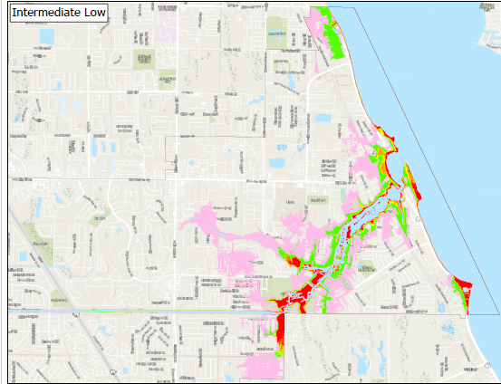
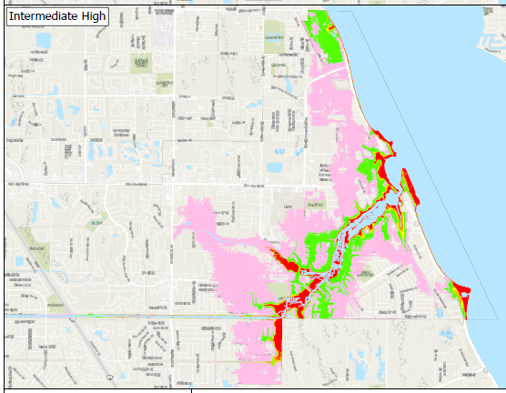
EXPOSURE ANALYSIS
Sea Level Rise + Storm Surge (2070)

Slide 19
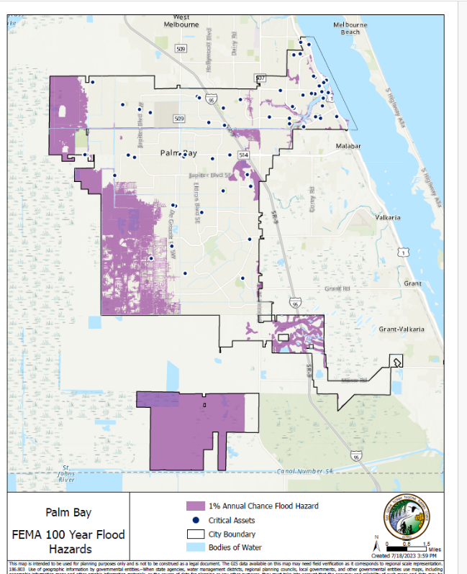
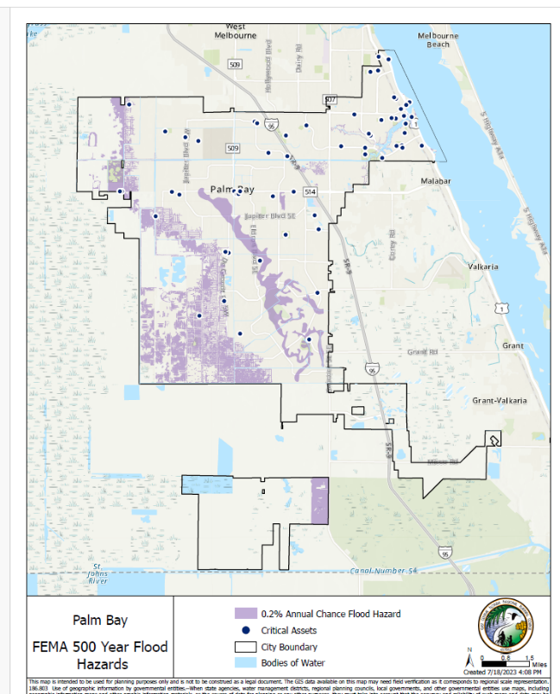
EXPOSURE ANALYSIS
FEMA Flood Zones

Slide 20
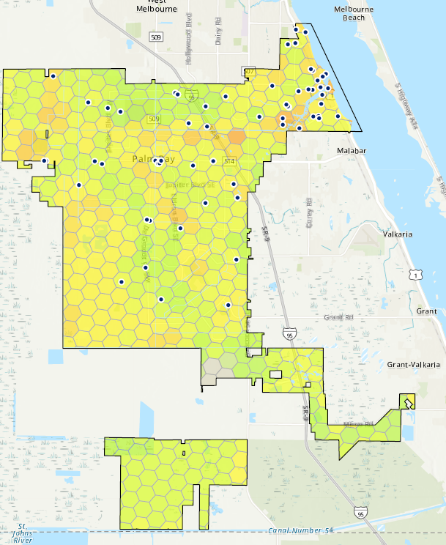
Sensitivity Analysis
Provides an Inventory of Community Assets, Such as Populations, Structures, and Economic Functions, and Quantifies and Measures the Impacts of Sea Level Rise on Those Assets.
Notes:
Flood exposure and sensitivity were also identified during each event scenario to create a baseline for adaptive measures in the future.
The sensitivity analysis builds on the exposure analysis but measures the impact of flooding on critical assets. The analysis provides an inventory of the critical assets and evaluates the impact of flooding on assets based on each flood scenario the assigned risk-level based on the inundation of land. The sensitivity analysis can also identify community characteristics such as affected populations, structures, and economic impacts. The most comprehensive approach will evaluate both critical assets as well as community characteristics.

Slide 21
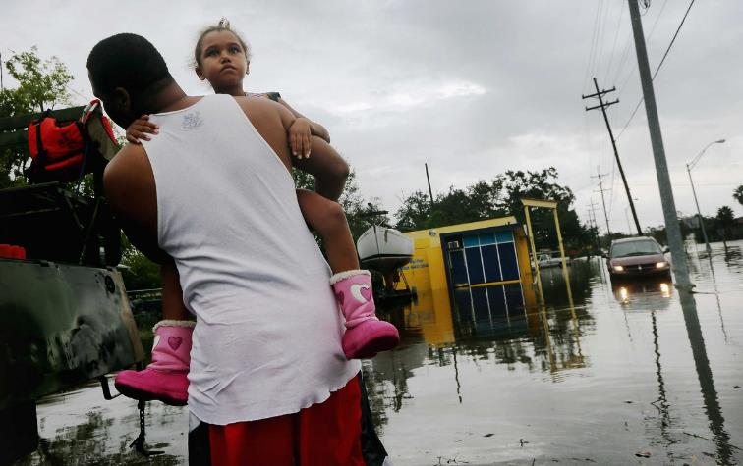
SENSITIVITY ANAYSIS
Sensitivity Analysis
Social Vulnerability Index (SoVi)
+ Regional Drivers Vulnerability
+ Population
+ Flooding
+ Natural Attributes (Vulnerable Landscapes)

Slide 22
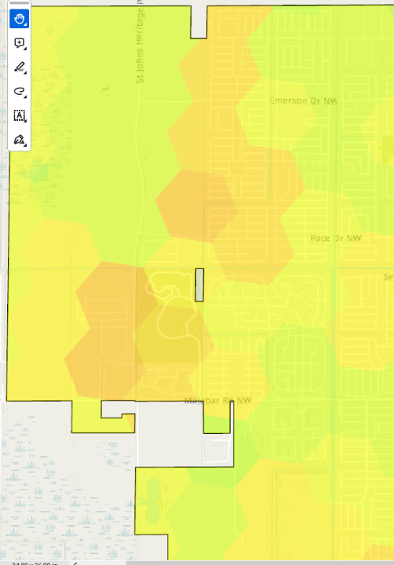
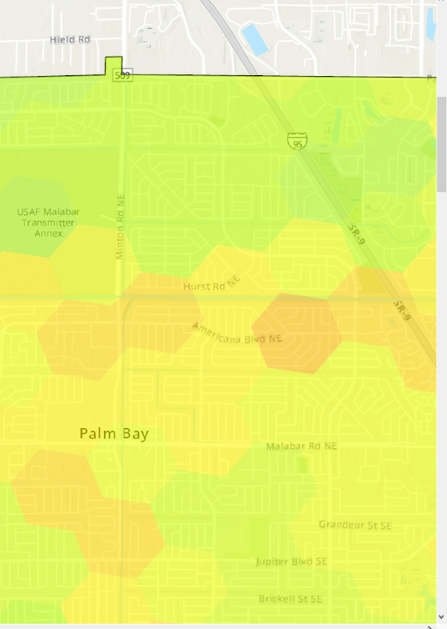
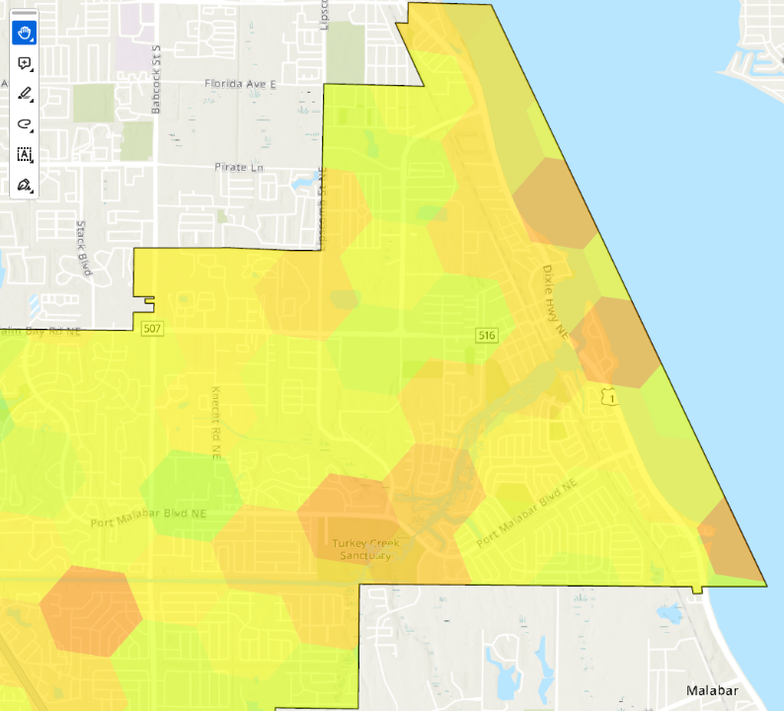
SENSITIVITY ANALYSIS
Areas of Concern

Slide 23
PUBLIC ENGAGEMENT
Public Engagement
Introduction Meeting- Today
Online Survey
Second Meeting- February

Slide 24
PUBLIC ENGAGEMENT
Online Survey
This QR Code Should Take You to the Project’s Online Survey
The Survey will be Live Today and Available Until Mid January

Slide 25
ASSESSMENT COMPONENTS
Report, Maps, and Tables
Vulnerability Analysis Report
Map Series for the Different Vulnerabilities
Asset Vulnerability Tables

Slide 26
ASSESSMENT COMPONENTS
Next Steps
PIRS Analysis- Stormwater and Road Network
Critical Commercial Corridors Exposure Analysis
Deep-Dive on Most Sensitive Areas

Slide 27
CONTACT INFORMATION
Questions/Comments
Luis Nieves-Ruiz , FAICP
Director of Economic Development
407-245-0300 x308
luis@ecfrpc.org

