Slide 1
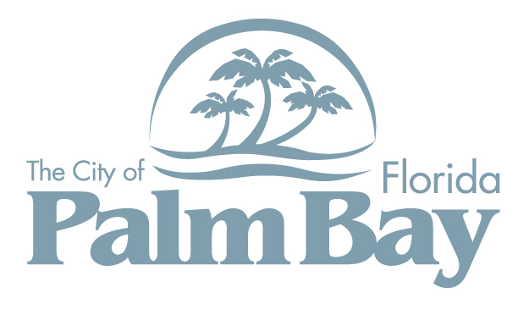
Compound Workshop
March 30, 2023

Slide 2
History of the Compound
Palm Bay was developed by General Development Corporation (GDC). Other former GDC communities include Port Charlotte, North Port, and Port St. Lucie.
“The Compound” is an area of Palm Bay which is comprised of approximately 2,942 acres, which includes rights-of-way, within Port Malabar Units 51, 52, and 53.
Consists of thousands of quarter-acre single family residential lots pre-platted by GDC and sold to individuals across the world in the ‘70s, ‘80s and very early ‘90s through “mail order land sales”.
GDC paved approx. 200 miles of road and installed basic stormwater infrastructure, such as ditches, outfalls, canals and headwalls.
Following the indictments of the company’s leadership, the company ultimately declared bankruptcy.

Slide 3
The Compound Stats
The compound contains a total of 4,978 parcels
Unit 51 is comprised of 1,339 parcels
Unit 52 is comprised of 1,931 parcels
Unit 53 is comprised of 1,708 parcels
There are 2,755 unique owners of land/property in the compound.
Saraland, LLC is the largest land owner, owning a total 775 parcels.
The City of Palm Bay owns 129 parcels, mostly rights-of-way.
Brevard County School Board owns several large tracts for future school sites.

Slide 4
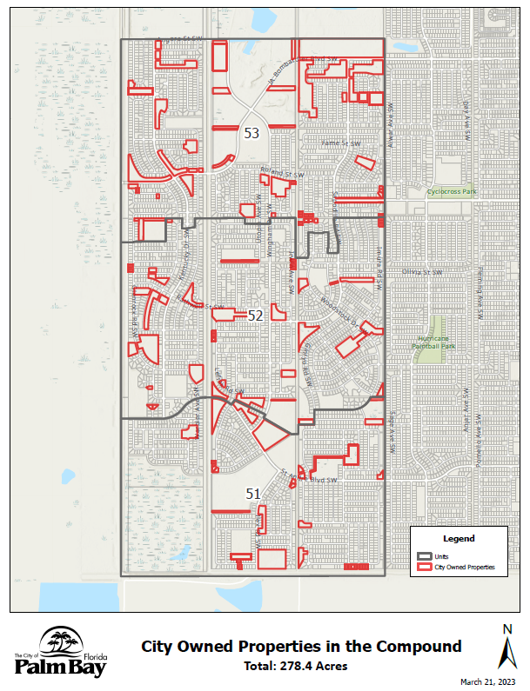
City Ownership
Of the 4,978 parcels, the City owns 129 parcels, or 2.6% of the parcels within the compound.
In terms of acreage, the City owns 278.4 acres, or 9.5%, out of the total 2,942 acres.
Several parcels appear to be future rights-of-way for roads, stormwater (i.e., canals/ponds), or future parks.

Slide 5
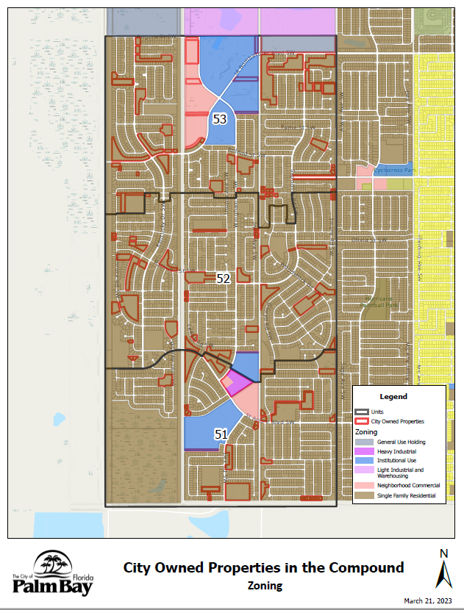
Existing Zoning
99.44% of parcels (4,978) within the compound are zoned Single Family Residential

Slide 6
Ownership & Control
The compound contains a total of 4,978 parcels.
The City of Palm Bay owns 2.6% (129 parcels) of the property within the compound.
David Moallem owns 16% (796 parcels) of the property within the compound. Moallem came to ownership through bankruptcy proceedings. Properties owned by Mr. Moallem include all properties owned by approx. 25 different entities including SARALAND LLC, Cogan-Wingham Partnership, David Moallem Trust, and others.
The remaining 81.4% (4,053 parcels) of the property within the compound is individually and privately owned.
There are 2,755 unique owners of land/property in the compound.

Slide 7
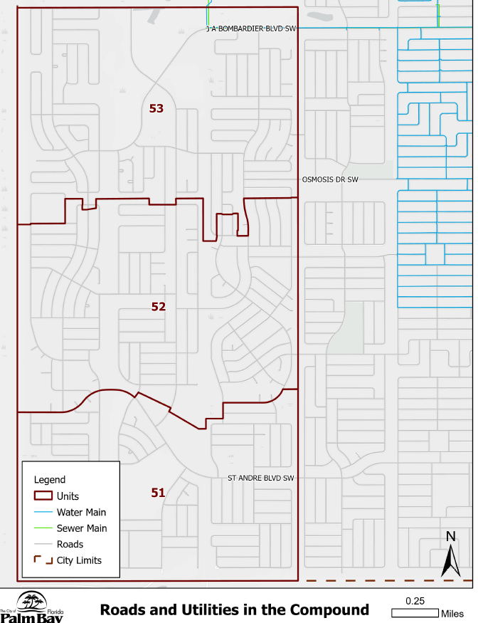
Primary Access Roadways & City Water

Slide 8
Access
J.A. Bombardier Blvd. SW
Osmosis Drive SW
St. Andre Blvd. SW
Future proposed extension of St. Johns Heritage Parkway south through Wingham Drive SW

Slide 9
Challenges
Limited access to area
Aging roads
Lack of water and sewer
No electricity
Varied ownership
Undesirable activity – trespassing; illegal or suspicious activity; dumping; noise and domestic disturbances; off road vehicles and reckless driving; deaths

Slide 10
Steps taken to address challenges
Police – The Palm Bay Police Department perform security checks. The PD performs on average 381 security checks annually.
Public Works (PW) – The PW Department performs clearing of overgrowth at key intersections in the compound.
Community & Economic Development (CED) – In 2020, the CED Department mailed letters to 24 property owners (32 lots) at the intersection of Bombardier Blvd, to learn of interest in selling or developing properties. The City received only four responses, an interest to sell. CED regularly engages with the EDC and developers to promote strategic development in the compound. Recently, there has been interest in the City’s 30 AC parcel on Bombardier, ¼ mile west of Madden Avenue SW.
The City (various departments) has held meetings with the EDC on strategies to attract development and FPL on expanding power to the compound. Staff have address a variety of questions from brokers, realtors, and developers on interest in assembling parcels.

Slide 11
Public Safety Statistics
Approximately 283 of the responses between 2017-2023 were for fire response or emergency medical services, to include 32 brush fires and 241 EMS & Fire response.
This does not include approximately 2,669 security checks performed by the Palm Bay Police Department between 2017-2023.

Slide 12
Police Response: 2023-to date

Slide 13
Police Response: 2022

Slide 14
Opportunities
Strategic growth and development in the commercial, industrial, and entertainment sectors bringing new private capital investment, jobs, and amenities for Palm Bay residents.
Bombardier Recreational Products (BRP)
Ecotourism, outdoor recreation, and entertainment amenities to support the recreation that currently occurs organically.
The Range
Hurricane Paintball Park
Drone Races by Florida Tech
Engine testing by Larsen Motorsports
Tough Mudder

Slide 15
Next Steps…
Addendum to Economic Development Strategic Plan in FY 2024
Redesignate FLU and Rezone sections along key corridors
ACE Corridor for St. Johns Heritage Parkway
FPL substation
Future City utilities plant expansion
Letters mailed to owners
Outside consultant to assist with studies, land assemblage, etc.
City received an unsolicited proposal from The Euclid Group in January 2023.
Public-Private Partnership (P3)
Special Assessments/Special Districts
Eminent domain

Slide 16
Any Questions?

