Slide 1
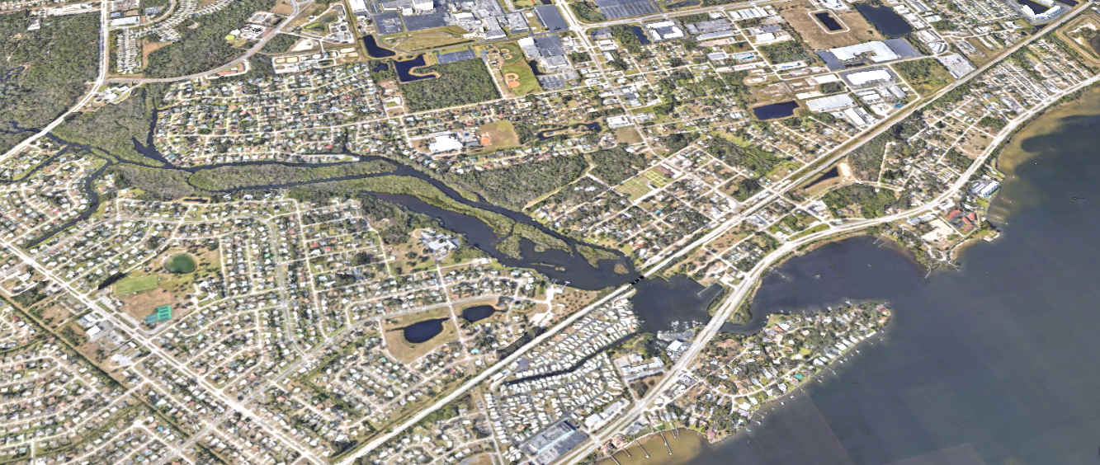
PUBLIC WORKSHOP
Tuesday, September 26th, 2023

Slide 2
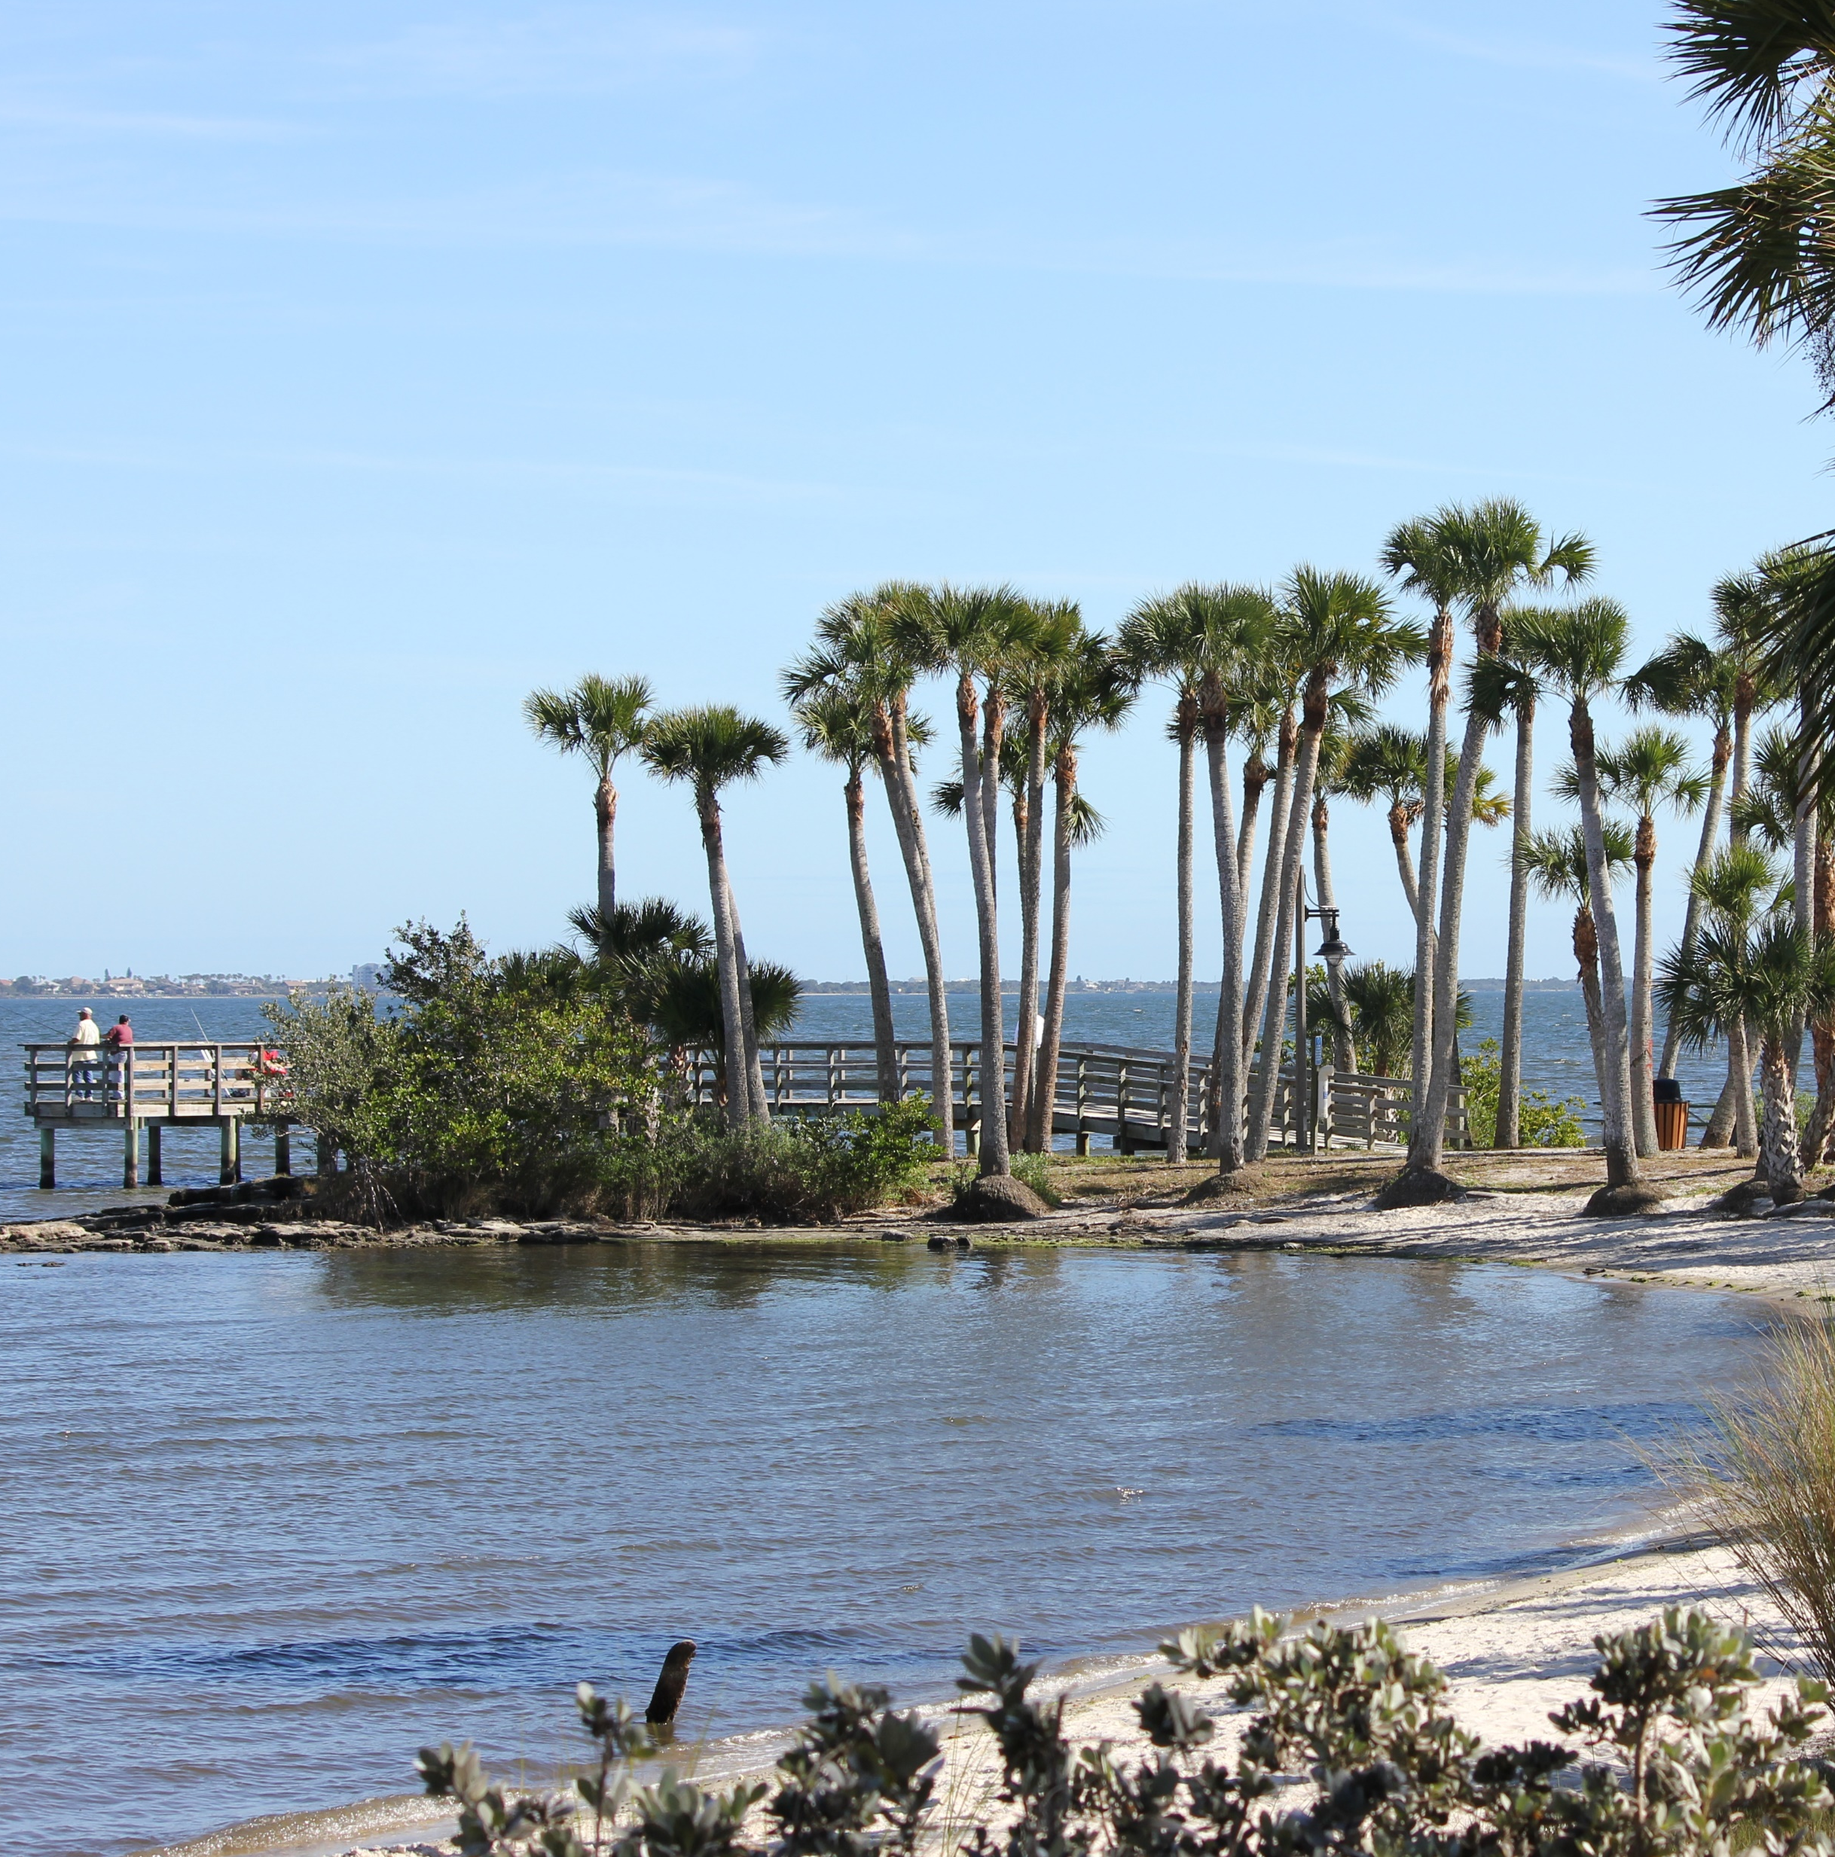
AGENDA
introductions
background
scope
major changes
next steps

Slide 3
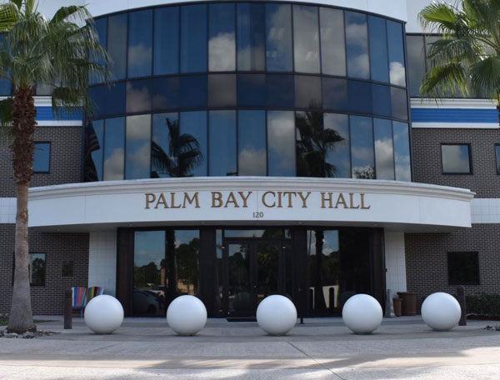
INTRODUCTIONS
Pat Tyjeski, AICP Project Manager
Chris Dougherty, AICP Principal Planner
Leslie Del Monte, AICP Senior Urban Design Specialist
Growth Management Department
Nick Hill, AICP Planner / GIS Specialist

Slide 4
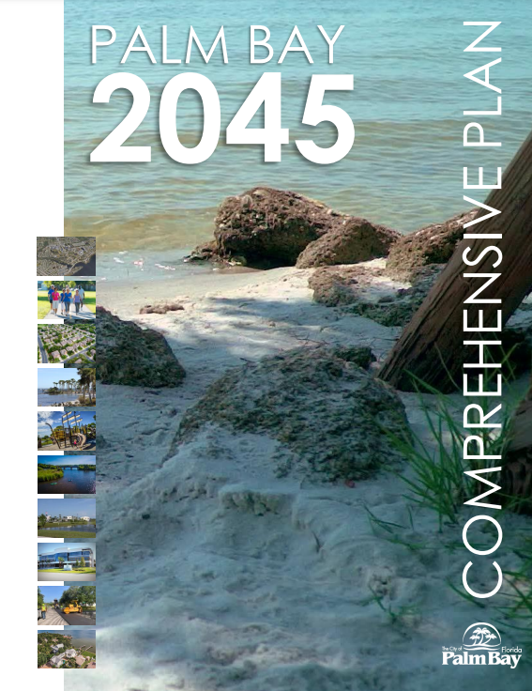
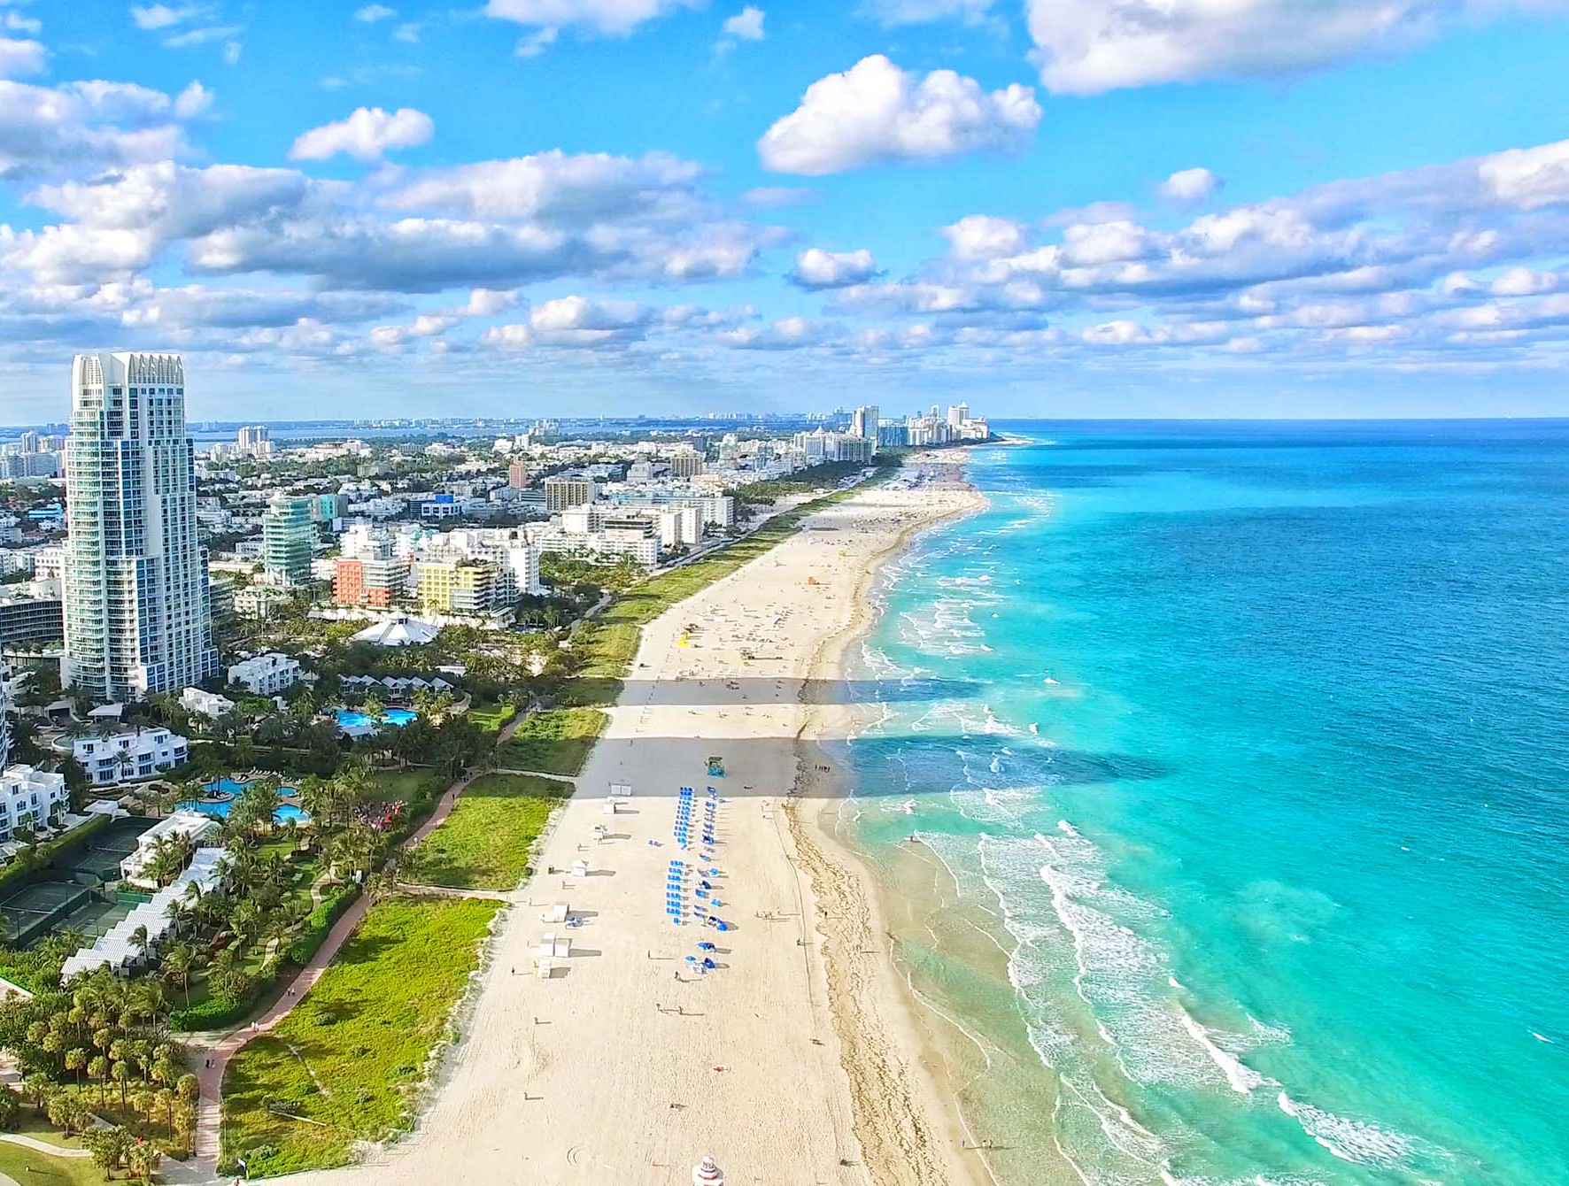
BACKGROUND
163.3202, F.S.
Land development regulations.
“Within 1 year after submission of its comprehensive plan … each municipality shall adopt or amend and enforce land development regulations that are consistent with and implement their adopted comprehensive plan.”
FLORIDA
STATUTES
2023

Slide 5
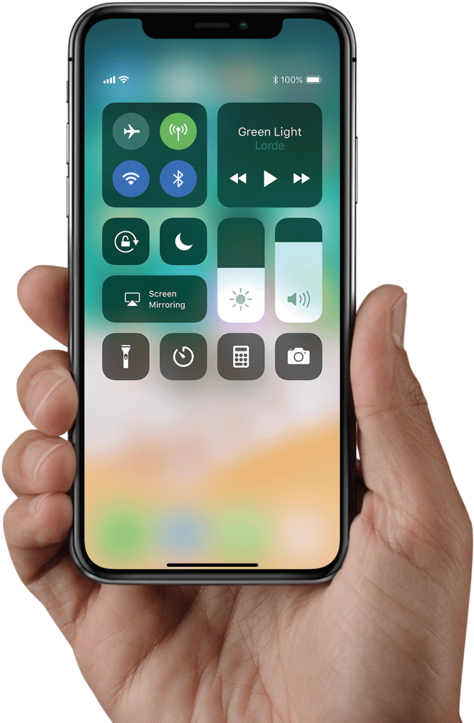
DIGITAL POLL – ROUND 1
VISIT
POLLEV.COM/INSPIRE2714
OR
SCAN

Slide 6
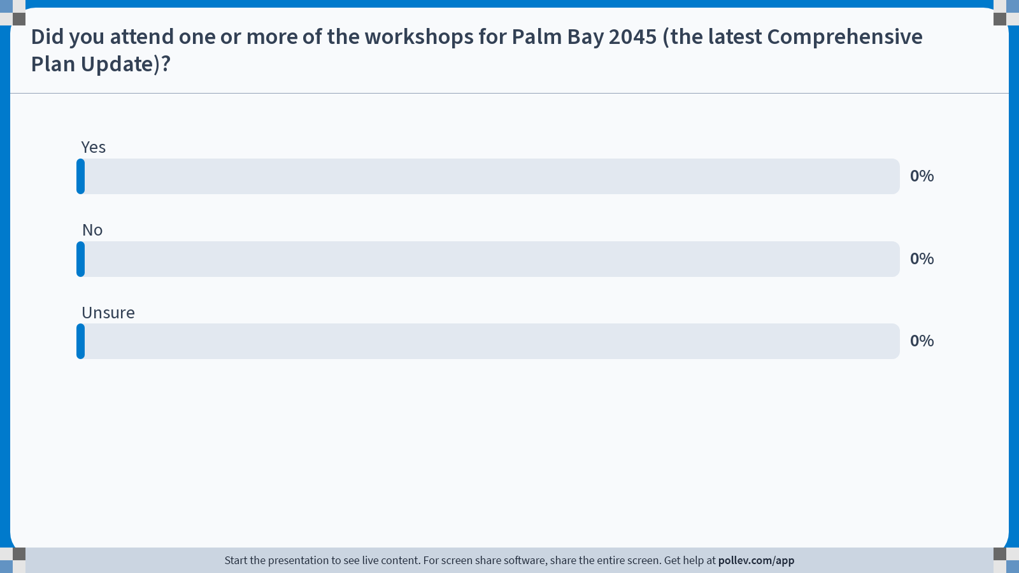
Notes:
Poll Title: Do not modify the notes in this section to avoid tampering with the Poll Everywhere activity. More info at polleverywhere.com/support Did you attend one or more of the workshops for Palm Bay 2045 (the latest Comprehensive Plan Update)? https://www.polleverywhere.com/multiple_choice_polls/wpeHFH6ltKYtXz53hpgPf

Slide 7
Notes:
Poll Title: Do not modify the notes in this section to avoid tampering with the Poll Everywhere activity. More info at polleverywhere.com/support What is your level of experience working with Land Development Codes? https://www.polleverywhere.com/multiple_choice_polls/akC1llW2U2TqCeI48zODc

Slide 8
PROJECT SCOPE
REORGANIZE
IMPLEMENT
UPDATE
1
2
3

Slide 9
PROJECT SCOPE
LDC Amend. Draft #1
LDC Adoption Draft
Public Workshop
Kick-Off
ADOPTION HEARINGS
April
May - August
September
26th
September - November
December 2023– February 2024
2023
2024

Slide 10
PROJECT SCOPE
CURRENT
PROPOSED
169. Land Development Code
170. Construction Codes and Regulations
171. Fair Share Impact Fees
172. Environmental Regulations
173. Adult Entertainment Code
174. Floodplain & Stormwater Management
175. Mining/Excavation Operations
176. Fuel Storage Tank Systems
177. Fire Prevention and Protection
178. Signs
179. Streets and Other Rights of Way
180. Trees and Shrubbery; Landscaping
181. Water Systems
182. Public Improvements
183. Comprehensive Plan Regulations
184. Subdivisions
185. Zoning Code
186. Communication Towers and Facilities
187. Administrative Moratoria
170. General Provisions
171. Definitions
172. Development Review Process
Zoning
Accessory, Temporary and Permanent Uses
Tree Protection, Landscaping, and Buffering
Streets, Parking, and Loading
Subdivision, Site, and Building Design
Signs
Natural Resources
REORGANIZE
IMPLEMENT
UPDATE
1
2
3

Slide 11
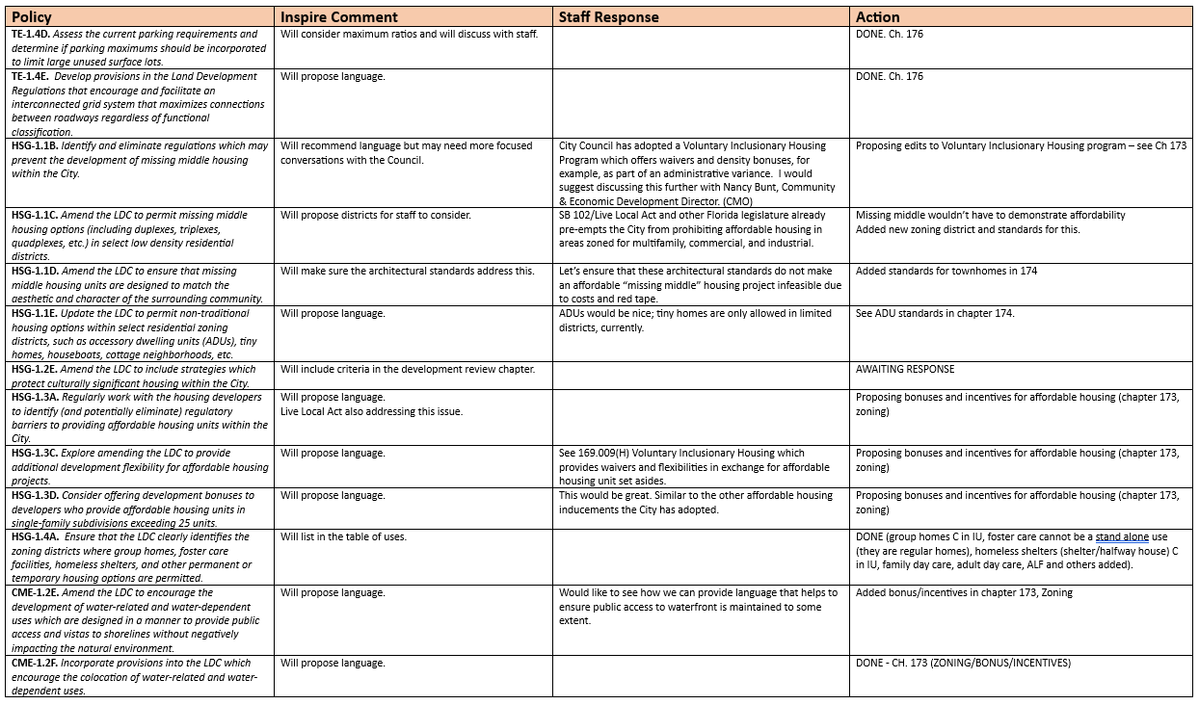
PROJECT SCOPE
REORGANIZE
IMPLEMENT
UPDATE
1
2
3

Slide 12
PROJECT SCOPE
ADDRESS INTERNAL INCONSISTENCIES
REVISE EXTERNAL CROSS REFERENCES
MOVE SECTIONS OUT OF THE LDC
REORGANIZE
IMPLEMENT
UPDATE
1
2
3

Slide 13
DIGITAL POLL – ROUND 2
VISIT
POLLEV.COM/INSPIRE2714
OR
SCAN

Slide 14
Notes:
Poll Title: Do not modify the notes in this section to avoid tampering with the Poll Everywhere activity. More info at polleverywhere.com/support Which of the following is an appropriate definition for a Land Development Code? https://www.polleverywhere.com/multiple_choice_polls/h9LRdHlx1Y6dWm4Wkhivp

Slide 15
Notes:
Poll Title: Do not modify the notes in this section to avoid tampering with the Poll Everywhere activity. More info at polleverywhere.com/support Which of the following is typically NOT part of a Land Development Code? https://www.polleverywhere.com/multiple_choice_polls/JiPllwyD9F6NmeMT1I4oB

Slide 16
MAJOR CHANGES
TOC
170. General Provisions
171. Definitions
172. Development Review Process
Zoning
Accessory, Temporary and Permanent Uses
Tree Protection, Landscaping, and Buffering
Streets, Parking, and Loading
Subdivision, Site, and Building Design
Signs
Natural Resources

Slide 17
MAJOR CHANGES
170
CHAPTER 170. GENERAL PROVISIONS
Contents:
Title
Authority — adoption
Purpose
Applicability; conformance
Conflict
Adoption of standards by reference
Administration and enforcement
Nonconformance provisions
Vested rights
Major Changes:
Repurposed to note purpose and applicability of entire LDC
Included non-conforming provisions with no changes
Included vested rights which combines two sections that were not together before

Slide 18
MAJOR CHANGES
171
CHAPTER 171. DEFINITIONS; ABBREVIATIONS AND ACRONYMS
Contents:
Definitions
Abbreviations and Acronyms
Major Changes:
Consolidated all definitions into a single chapter
Deleted terms not used in the LDC
Updated definitions to match statutes
Moved standards out of definitions
Added definitions for:
Access
Adult day care center
Affordable housing
Community residential home/ resident
Gross density
Educational service establishment
Emergency storm shelter
Equipment sales, rental, leasing
Family day care home
Floor area ratio
Government establishments
Impervious surface ratio
Infill development
Living shoreline
Mixed-use
Common open space
Pet day care facility
RV park
Service establishments (business, intensive, personal)
Sharrow
Shelter/halfway house
Canopy and understory trees
Vehicle repair, light
Water dependent/related use

Slide 19
MAJOR CHANGES
172
CHAPTER 172. DEVELOPMENT REVIEW PROCEDURES
Contents:
Applicability
General Procedures (citizen participation plans, hearings, DRC, appeals, table of application types)
Application Types (annexations, plan amendments, rezones, LDC amendments, site plans, conditional uses, variances, master plans)
Zoning Map Amendment to Planned Development
Subdivision Application and Approval Process
Concurrency Management System
Proportionate Fair Share Transportation
Major Changes:
Recommend moving procedures to a manual
Created summary table of application types
Added section explaining pre-application meetings
Proposed the creation of a Development Review Committee (DRC)
Added a summary section explaining hearings
Consolidated all appeal provisions into a single location
Added section on annexation reviews
Updated section on comprehensive plan amendments
Clarified review procedures for all application types
Standards specific to certain uses moved to Chapter 174
Proposed to delete section on Planned Industrial (does not require anything)
Proposed new procedure to review mixed-use developments that meet code (as opposed to PUDs which deviate from code)

Slide 20
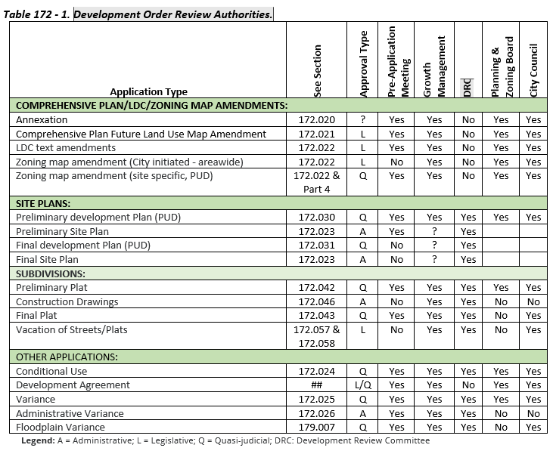
MAJOR CHANGES
172
DEVELOPMENT REVIEW PROCEDURES

Slide 21
MAJOR CHANGES
173
CHAPTER 173. ZONING
Contents:
PART 1. GENERAL PROVISIONS
Application
Zoning Districts Established
Zoning Map
PART 2. STANDARD ZONING DISTRICT REGULATIONS
Intent of Standard Zoning Districts
Schedule of Uses
Bulk and Dimensional Standards
Bulk and Dimensional Standards – General Provisions
PART 3. PLANNED DEVELOPMENT ZONING DISTRICT REGULATIONS
Planned Unit Development (PUD)
PART 4. BONUSES AND INCENTIVES
Affordable Housing Bonus
Green Building Incentive Program
Development Bonuses and Incentives
PART 5. DEVELOPMENT DESIGN STANDARDS
Townhomes
Multifamily Dwellings
Commercial and Office Districts
Mixed-Use District (MU) Design Standards
Mixed-Use Core District (MUC) Standards

Slide 22
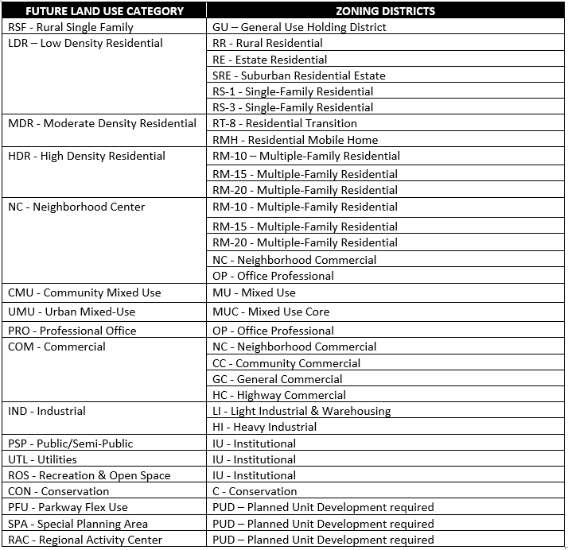
MAJOR CHANGES
173
Added a table to identify which zoning districts implement each Future Land Use category.
Permitting small-scale office uses within residential FLU categories when properties are ill-suited for residential development
Consolidated similar districts (including PUDs) and eliminated underutilized zoning categories
Added a new zoning district (RT-8) which permits moderate density residential development inclusive of missing middle housing

Slide 23
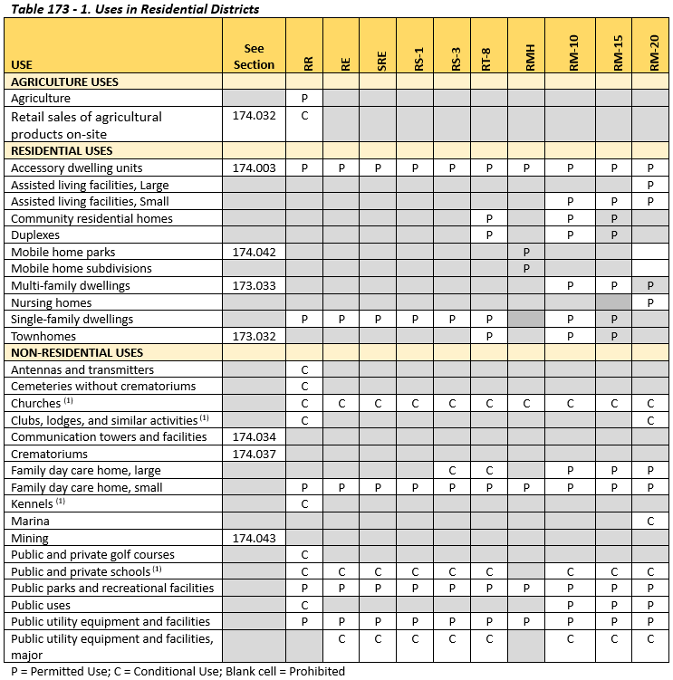
MAJOR CHANGES
173
Created a series of tables listing the uses that are allowed as permitted by right or through conditional use within each zoning district
Refined standards for developments within mixed-use zoning districts
Establish new standards for townhomes, multi-family, and mixed-use developments.

Slide 24
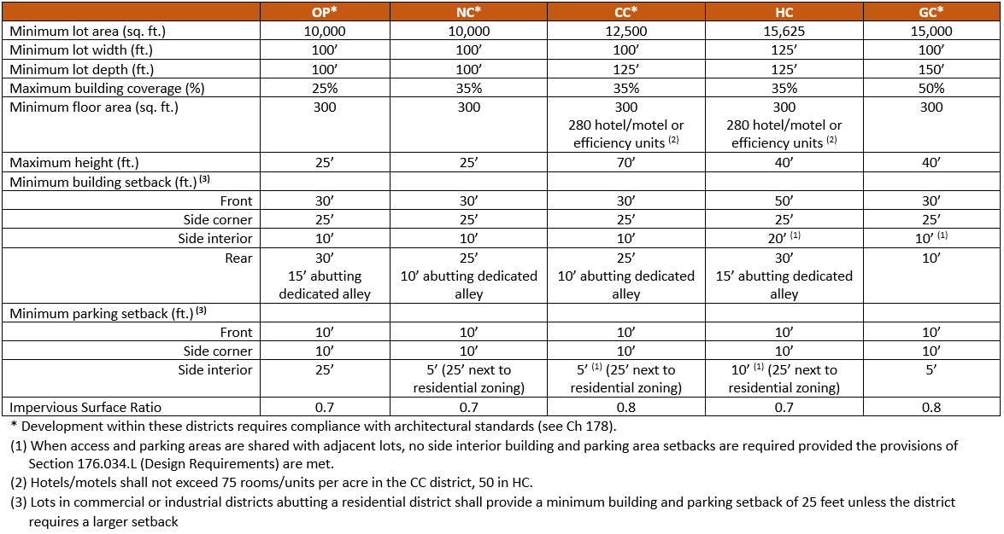
MAJOR CHANGES
173
Dimensional Standards Tables. Added tables listing development standards for each district

Slide 25
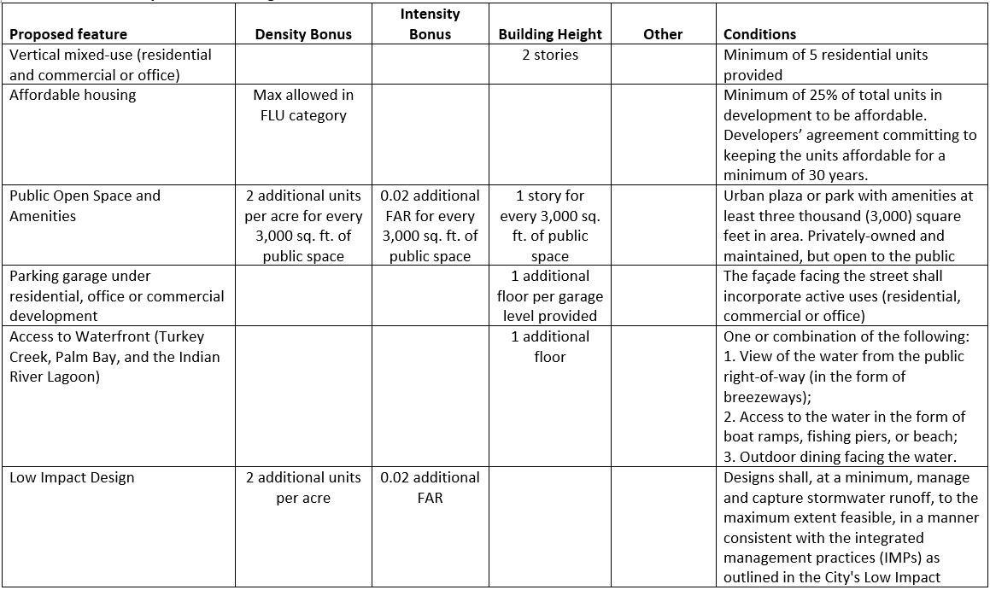
MAJOR CHANGES
173
Bonuses & Incentives Table. Refined and expanded opportunities for density, intensity, and building height bonuses for new development when the following is provided:
vertical mixed-use
affordable housing
public open space
parking garage
waterfront access
low impact & green building design
emergency storm shelters
living shoreline techniques
colocation of water dependent and related uses

Slide 26
MAJOR CHANGES
174
CHAPTER 174. ACCESSORY, TEMPORARY AND OTHER USES
Contents:
PART 1. ACCESSORY USES AND STRUCTURES
Purpose
Accessory Uses & Structures General Requirements
Accessory Dwelling Units
Air Conditioning Units
Fences And Walls
Home Occupations
Outdoor Dining
Piers, Docks and Boathouses
Security Dwelling
PART 2. TEMPORARY USES AND STRUCTURES
Purpose
Model Homes
Temporary Mobile Homes for Office Use
Temporary Storage Units in Residential Areas
PART 3. STANDARDS FOR SPECIFIC USES
Adult entertainment establishments
Agricultural products sales
Arcade/amusement centers
Communication towers/facilities
Contractors’ offices
Corrections facilities
Crematoriums:
Eating and drinking establishments
Event halls.
Fuel storage tank systems
Gasoline/fuel, propane, and natural gas sales
Manufactured housing and mobile homes
Mining / excavation operations
Mobile vending units.
Model home center
Neighborhood commercial
Outdoor display of merchandise
Parking garages
Pet day care
Recreational vehicle parks
Salvage yards
Self-storage facilities
Tree and landscape recycling
Vehicles, major recreational equipment, and mobile homes sales, rentals, and storage
Vehicle repair
Wedding venues.

Slide 27
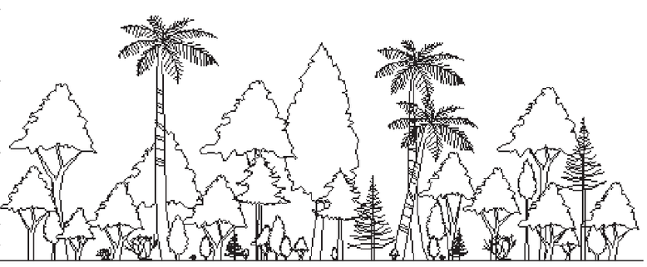
MAJOR CHANGES
175
CHAPTER 175. TREE PROTECTION, LANDSCAPING, BUFFERING
Contents:
PART 1. TREE PRESERVATION AND REMOVAL CODE
Intent
Applicability; Permit Required
Exceptions
Protection of Trees During Construction
Tree Removal Permit
Violations
PART 2. LANDSCAPING AND BUFFER REQUIREMENTS
Purpose And Intent
Landscaping Standards for Single- and Two-family Residential Lots
Landscaping Within Vehicular Use Areas
Landscaping In Other Interior Site Areas
Street Trees in Residential Developments
Perimeter Landscaping and Buffer Requirements
Landscape Materials
Installation and Maintenance
Major Changes:
Major reorganization
Added requirements for street trees in new subdivisions
Created table for perimeter landscaping/ buffers
Introduced concept of street walls to hide parking areas

Slide 28
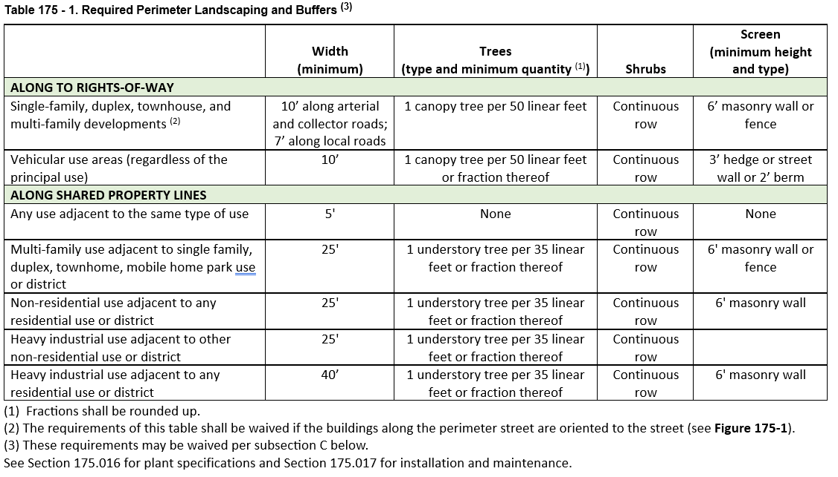
MAJOR CHANGES
175

Slide 29
MAJOR CHANGES
176
CHAPTER 176. STREETS, PARKING, AND LOADING
Contents:
PART 1. STREETS AND SIDEWALKS
Purpose.
Applicability.
Street Design.
Right-of-way and Easement Use
Restoration of Damaged Areas.
Street Names.
Vision Clearance at Corners, Curb Cuts and Railroad Crossings.
Culverts and Curbing.
Access to Commercial and Industrial Land.
Traffic-control Devices.
Sidewalks And Bikeways.
PART 2. DRIVEWAYS
Permit Required.
Residential Driveways.
Non-residential Driveways.
Design and Construction Requirements.
PART 3. TRANSIT FACILITIES.
Transit Facilities.
PART 4. OFF-STREET PARKING REQUIREMENTS
Purpose and Intent.
Applicability.
Exemptions.
General Requirements.
Design Requirements.
Shared Parking.
Parking Computations.
Amount of Off-street Parking Required.
Satellite Parking.
Parking Rate Adjustment.
Paving Standards.
Vehicular and Pedestrian Interconnections.
Conversion of Garages to Living Area.
PART 5. OFF-STREET LOADING AND SERVICE.
Purpose.
Off-street Loading Standards.

Slide 30
MAJOR CHANGES
177
CHAPTER 177. SUBDIVISION, SITE AND BUILDING DESIGN
Contents:
PART 1. SUBDIVISION DESIGN
Purpose.
Interpretation and Conflict.
Design of Lots and Blocks.
Common Open Space and Amenities.
Frontage on Street.
Subdivision Street Design.
Sidewalks/Pedestrian Ways.
Utilities and Easements.
Design of Stormwater Management.
Water and Sewerage Facilities.
Public Uses.
Preservation of Natural and Historic Features.
Nonresidential Subdivisions – Additional Provisions.
PART 2. STORMWATER MANAGEMENT AND CONSERVATION
Finding of Facts.
Objectives.
Vested Rights; Prior Law.
Stormwater Management Plan.
Performance Standards.
Design Standards.
Dedication of Stormwater Management Facilities.
Permit Fees.
Outside Agency and Governmental Entities Coordination.
Single-family Residential Construction.
Violations.
PART 3. LIGHTING STANDARDS
Lighting Standards.

Slide 31
MAJOR CHANGES
178
CHAPTER 178 – SIGNS
NO CHANGES OTHER THAN NUMBERING

Slide 32
MAJOR CHANGES
179
CHAPTER 179. NATURAL RESOURCES
Contents:
PART 1. FLOODPLAIN MANAGEMENT
General Requirements.
Applicability.
Duties And Powers of the Floodplain Administrator.
Permits.
Site Plans and Construction Documents.
Inspections.
Variances and Appeals.
Violations.
Buildings and Structures.
Subdivisions.
Site Improvements, Utilities, and Limitations.
Manufactured Homes.
Recreational Vehicles and Park Trailers.
Tanks.
Other Development.
Storage of Hazardous Materials.
Critical Facilities.
Applicability.
PART 2. GROUNDWATER/WELLFIELD PROTECTION
Purpose.
Land Use and Distance Requirements from Active Designated Public Utility Water Wells.
Fuel Storage Tank and Pump Construction.
Vested Rights.

Slide 33
MAJOR CHANGES
MOVE
SECTIONS PROPOSED TO BE MOVED OUT OF THE LDC (TO PUBLIC WORKS MANUAL OR OTHER TITLES IN THE CODE OF ORDINANCES)
Construction Codes and Regulations (Chapter 170)
Fire Prevention and Protection (Chapter 177)
Adult Entertainment Code (Chapter 173)
Park, Police and Fire Impact Fees
Transportation Facilities Impact Fee
Water And Wastewater Impact Fees
Public Nudity
Regulation of Vehicles in Residential Areas (§ 185.123).
Golf Carts
Limitations on the Number of Dogs Kept Within Residential Zoning Districts (§ 185.131).
Backyard Chickens (§ 185.136).
Pigeons (§ 185.137).
Water and Sewers (Chapter 181)
Stormwater Management Utility
Roadway Surfacing (§ 179.033)
Street Name Signs (§ 179.031 ).
Closure and Abandonment of Easements and Drainage Rights-of-way
Permit Procedures and Requirements (§ 179.096)
Design, Material, Testing and Reports (§ 179.097)
Construction Procedures (§ 179.098)
Emergency Work (§ 179.099)
Application submittal requirements

Slide 34
NEXT STEPS
TONIGHT
BOARDS
DOCUMENT REVIEW
A
B

Slide 35
NEXT STEPS
MOVING FORWARD
1
REVISE
2
ADOPT
September - November
December – February

Slide 36
THANK YOU!

