Slide 1
Turkey Creek Restoration Feasibility Study Summary City of Palm Bay
April 20, 2023

Slide 2
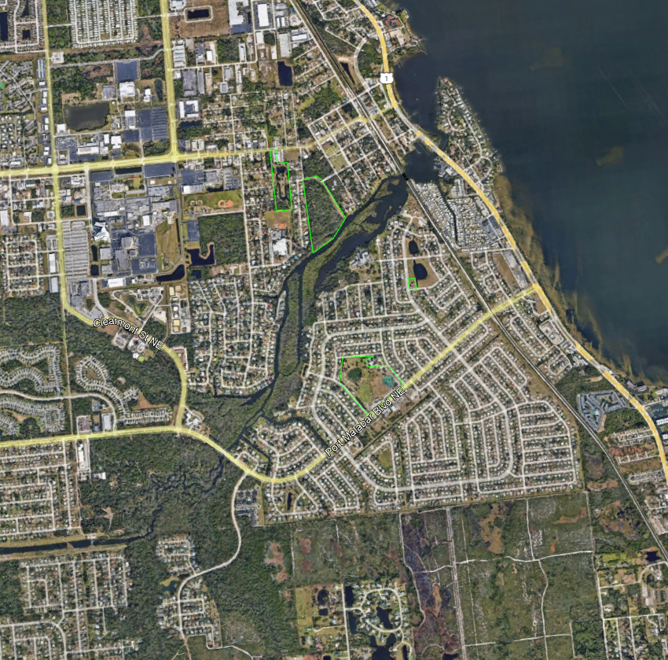
Turkey Creek Summary
City acquired a FDEP 319 Grant for $160,000 for Turkey Creek restoration feasibility study
Geosyntec and Applied Ecology performed a holistic approach to identify improvement opportunities

Slide 3
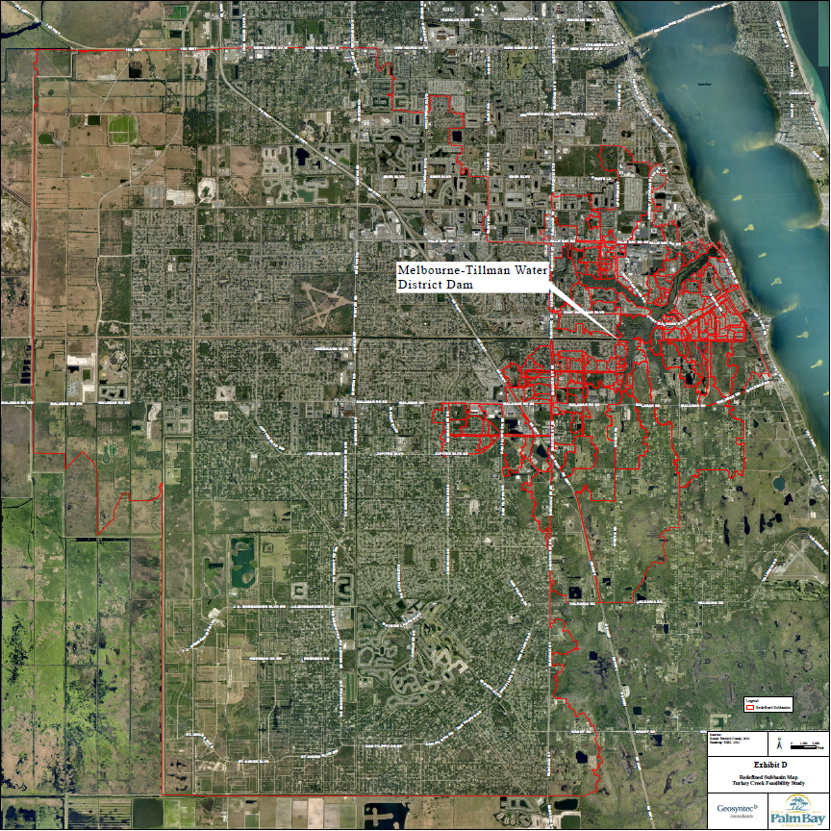
Turkey Creek Summary
Specifically, the project examined
Muck dredging
Cadillac Island removal and Sump Maintenance
Ecological restoration
Benefits of mechanical harvesting vs herbicides
Wastewater treatment systems
Stormwater and baseflow

Slide 4
Turkey Creek Summary: Dredging of Turkey Creek
Dredging under current authorization (>5 foot deep)
Several areas under 5-foot deep with nutrient rich sediment
Removal of muck represents several benefits
Improved flow conditions
Reduced nutrient reservoir
Restore safe navigational access
Limitations
Will not reach natural substrate in areas, will continue/increase nutrient flux
No BMAP credit for these areas
Has not, by itself, provided long-term net benefit

Slide 5
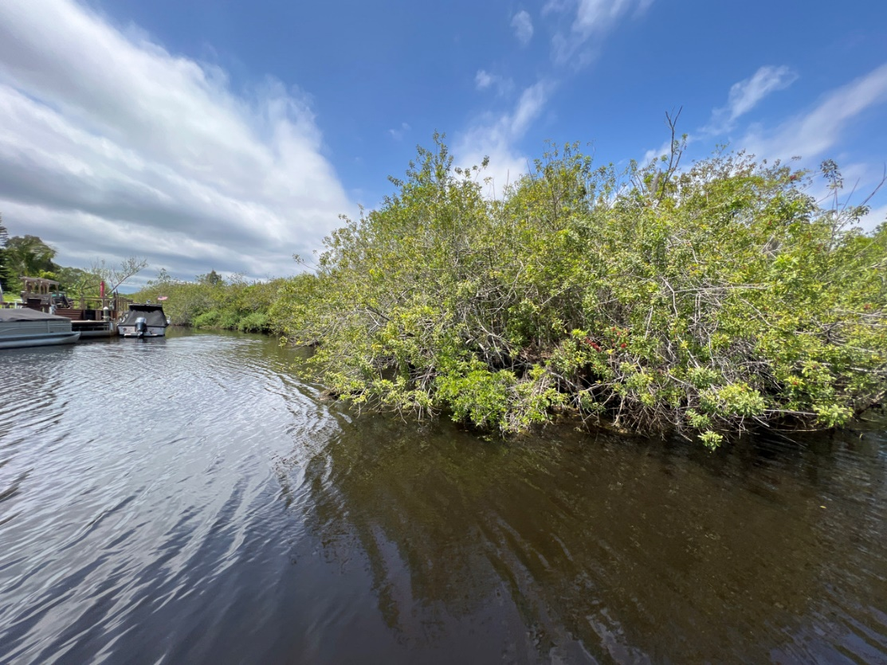
Turkey Creek Summary: Excavation and Dredging of Islands
Removal of Cadillac Island
Improves flushing and local navigation
Ecological net gain due to exotics dominance
Maintenance of sump
Annual inspection and after major storm events

Slide 6
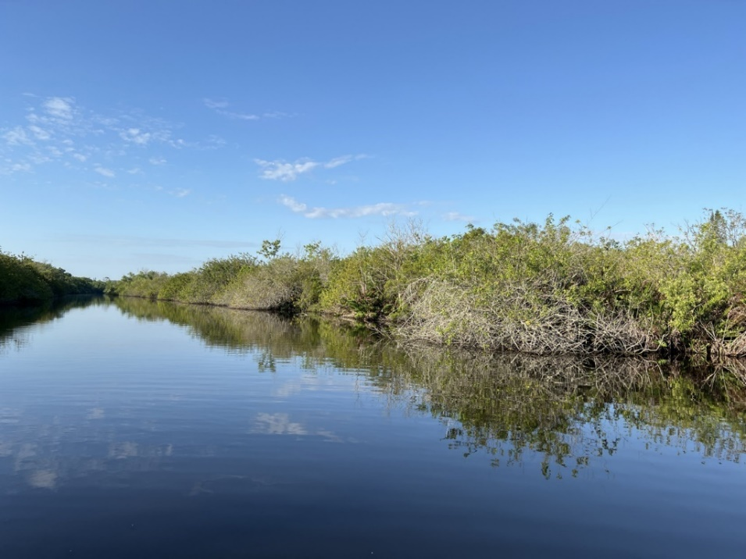
Turkey Creek Summary: Ecological Restoration - Outlaw Island
Removal of Invasive Species and Restoration of Native Plants
Priority Project: Outlaw Island Restoration
Overgrown with Brazilian pepper, Chinese tallow, elephant ear, climbing hemp fern

Slide 7
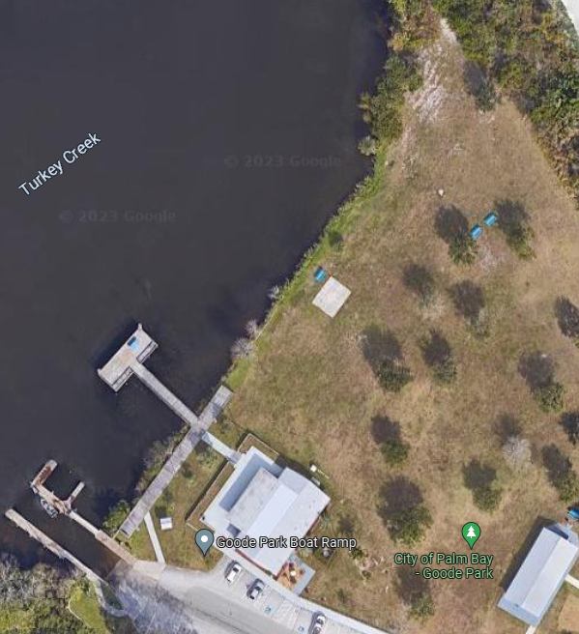
Turkey Creek Summary: Ecological Restoration - Goode Park Shoreline Enhancement
Shoreline enhancements
Priority Project: Goode Park (650 linear feet)
Installation of a swale landward of top of bank, create softer side slope and plant desirable vegetation)
Largest immediate public benefit
Enhancement proposed east of the limits of the public fishing pier to property line
Reduce erosion and nutrient runoff
Improve fishery habitat and aesthetics

Slide 8
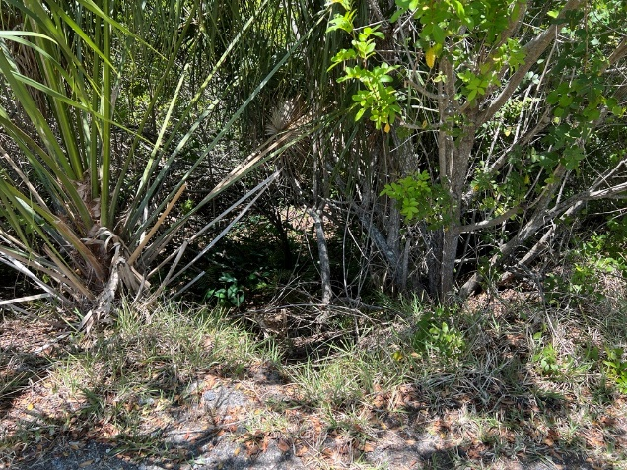
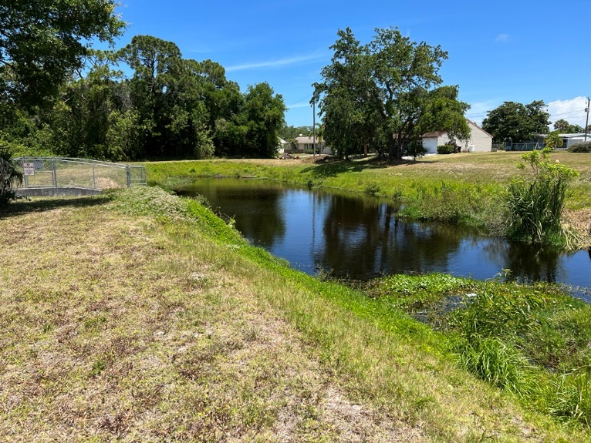
Turkey Creek Summary : Stormwater Pond Ecological Restoration – Chace Lane/Cadillac
Repair stormwater pond/ Also a WQ project!
Weir discharging steadily into Turkey Creek
Remove Brazilian Peppers and replace with native vegetation
Area west of stormwater pond (1.5 acres)
Cadillac Drive wetland area
Improve wetland hydrology
Redirect stormwater to wetland
Additional treatment

Slide 9
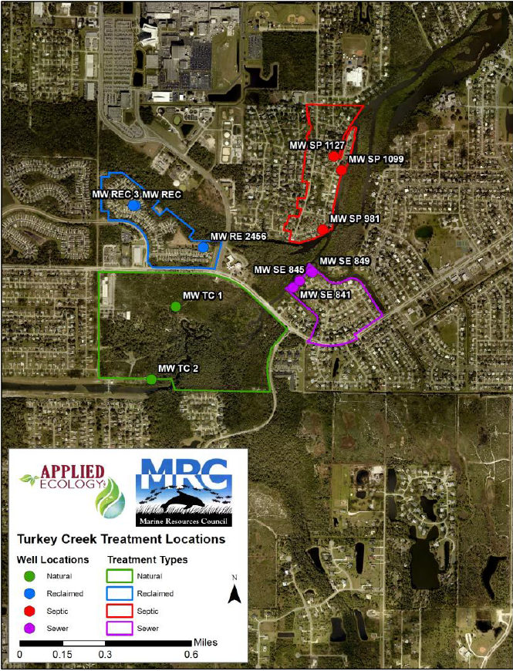
Turkey Creek Summary: Wastewater Improvement Project Identification
Summary of available wastewater information was reviewed
Septic systems – number of projects identified in previous studies and proposed for SOIRL funding
Wastewater infrastructure – recently upgraded selected older communities
Water reclamation facilities –upgraded to reduce effluent, continuing to monitor impact
Groundwater monitoring study (AEI) – identified areas of interest
Recommend building on previous efforts

Slide 10
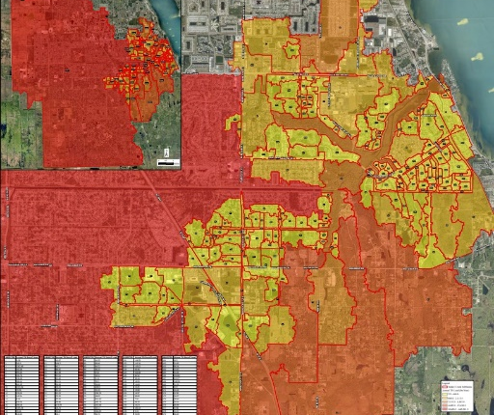
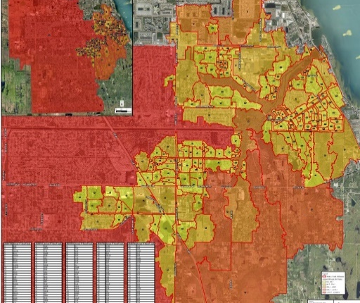
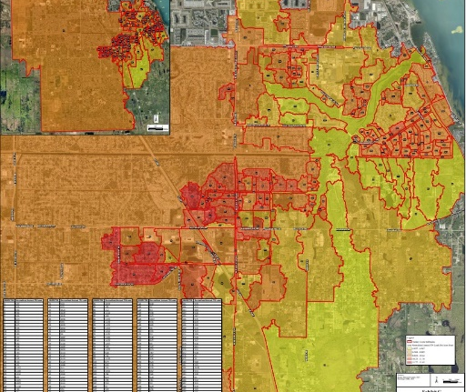
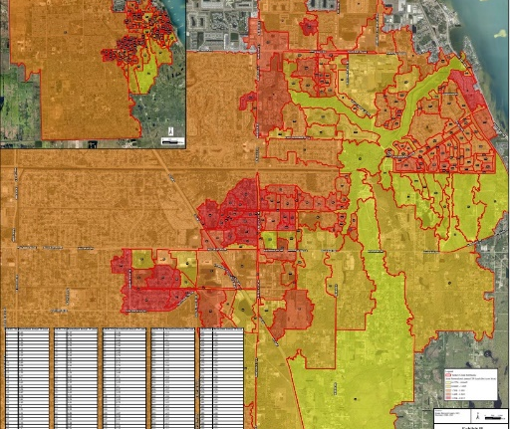
Turkey Creek Summary: Stormwater and Baseflow Nutrient Loading
Refined subbasins used to determine TN and TP loading
Performed Hotspot analysis based on subbasin TN and TP loading
Identified water quality improvement projects
Develop concept
Evaluate pollutant removal performance
Perform cost benefit analysis
TN Hotspot Maps
TP Hotspot Maps

Slide 11
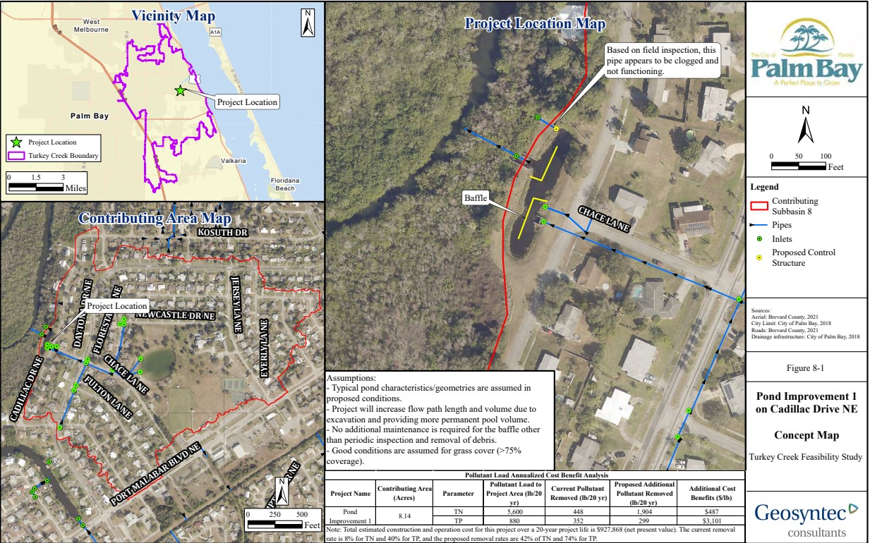
Turkey Creek Summary: Stormwater and Baseflow Improvement Project – Cadillac Drive
Enhance and repair pond
Project cost $927,868
Removal of 95.2 lbs/yr TN & 15 lbs/yr TP
Cost benefit
$487 /lb TN
$3,101 /lb TP

Slide 12
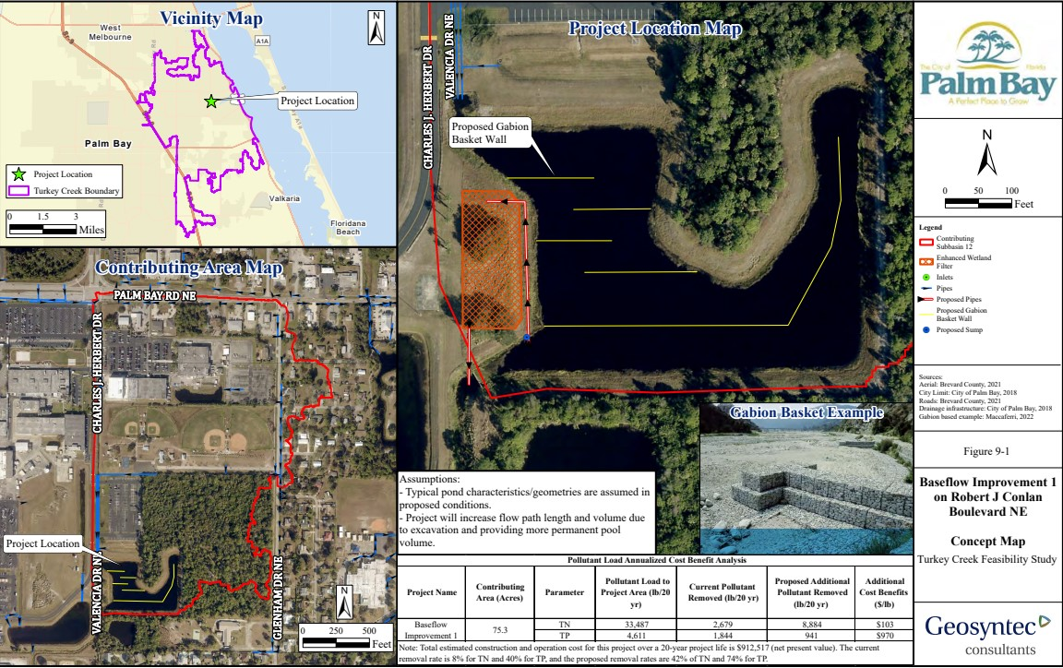
Turkey Creek Summary: Stormwater and Baseflow Improvement Project – Robert J Conlan Blvd
Enhance pond and add wetland filter and pump
Project cost $912,517
Removal of 444.2 lbs/yr TN & 47.1 lbs/yr TP
Cost benefit
$103 /lb TN
$970 /lb TP

Slide 13
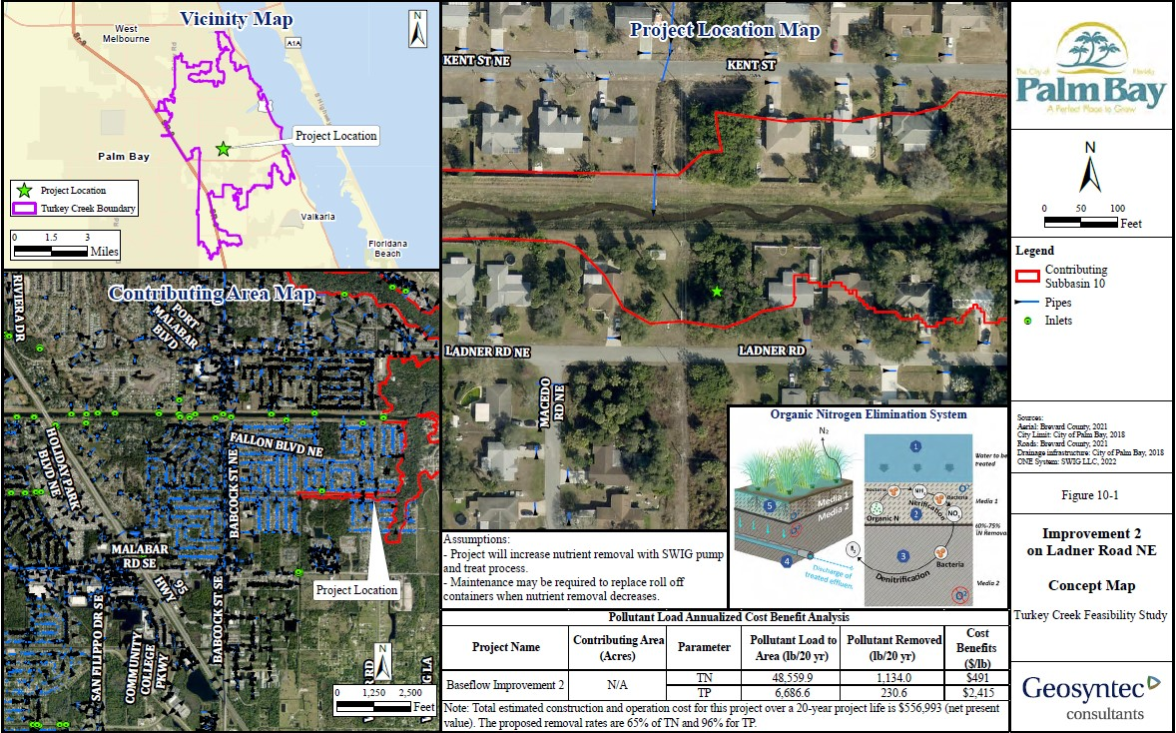
Turkey Creek Summary: Stormwater and Baseflow Improvement Project – Ladner Road NE
Add pump and containerized filtration system for baseflow treatment
Project cost $556,993
Removal of 56.7 lbs/yr TN & 11.6 lbs/yr TP
Cost benefit
$491 /lb TN
$2,415 /lb TP

Slide 14
Turkey Creek Summary: Potential Funding Sources
FDEP
Clean Water State Revolving Fund
FDEP 319(h) Grants (typically require 40% match)
FDEP Water Quality Assistance Grants (no match)
FDEP Wastewater Grant Program
Resilient Florida Grants (Planning, Implementation, Supplemental; some have match)
Division of Water Restoration Assistance (DWRA) – wastewater grant program
IRC/IRLNEP Program
Water quality focused
SOIRL
Funding through SOIRL Trust Fund (due annually the first week of October)
Florida Legislature
Appropriations

Slide 15
Turkey Creek Summary: Recommendations
Keep holistic approach to restoration
Invest in data collection
Surface water sampling
Stormwater sampling
Sediment assessment
Implement priority ecological restoration projects
Perform sediment island removal and maintain sump
Perform in-creek sediment assessment and evaluate long-term dredging benefits

Slide 16
Turkey Creek Summary: Recommendations
Transform aquatic vegetation management program from chemical treatment to mechanical harvesting
Implement septic to sanitary project recommended by Wade Trim (2017)
Implement recommended stormwater and baseflow projects
Perform water quality assessment of MTD Canal watershed and identify upstream projects

Slide 17
Questions??

