Slide 1

TECHNICAL ASSISTANCE WORKSHOP
American Rescue Plan Act (ARPA)
Request for Applications (RFP)
July 11, 2022

Slide 2
ARPA allocation to City of Palm Bay
$360 Billion in Direct Aid to State and Local Government
$18,009,865 to the City of Palm Bay
Disbursement in two equal annual tranches
First disbursement of $9,004,932.50 received on June 17, 2021
Second disbursement of $9,004,932.50 to be drawn in June 2022
Funding to be expended or earmarked by December 31, 2024
Funding to be fully expended by December 31, 2026

Slide 3
Request for Information (RFI):
Homelessness & Affordable Housing
March 1 – April 4, 2022
12 responses
Non-Profit and For-Profit Organizations
Proposed amount of funds range $75,000 - $5 million
Use of funds range from public services to construction of shelters and affordable housing

Slide 4
City Council authorizes use of ARPA
Tier 1 – emergency housing and public services/assistance
Tier 2 – temporary housing + case management = supportive housing
Tier 3 – permanent affordable housing
Palm Bay City Council allocates $5 million in ARPA funding to achieving all three tiers. City published a Request for Applications (RFA) on June 10, 2022.

Slide 5
ARPA Request for Applications
All information will be posted to www.pbfl.org/ARPA
All applications due no later than 5 PM on August 15, 2022
No application will be reviewed or evaluated before August 16, 2022
Applications will be considered by City Council during a Special Council Meeting in September, date to be determined
City Council may select one or multiple applications to fund
Subrecipient Agreement(s) shall be executed
Funds shall be fully expended by December 31, 2026

Slide 6
ARPA Eligibility Requirements
Requests should not exceed $5 million
Use of funds should address homelessness, affordable housing, and public services related to such
Activities shall occur within the city limits of Palm Bay or directly serve Palm Bay residents
Non-profits and for-profits are both eligible
Collaboration between multiple agencies is eligible
Late or incomplete applications will not be considered

Slide 7
American Rescue Plan Act (ARPA)
Coronavirus State and Local Fiscal Recovery Funds – Eligible Uses*
Respond to the public health emergency or its negative economic impacts, including assistance to households, small businesses, and nonprofits, or aid to impacted industries such as tourism, travel, and hospitality;
Respond to workers performing essential work during the COVID-19 public health emergency by providing premium pay to eligible workers;
The provision of government services to the extent of the reduction in revenue due to the COVID–19 public health emergency relative to revenues collected in the most recent full fiscal year prior to the emergency; and
Make necessary investments in water, sewer, or broadband infrastructure
* All proposed activities shall comply with the Department of Treasury’s Final Rule published on January 6, 2022, as released by the Office of the Federal Register, 31 CFR Part 35, RIN 1505-AC77.

Slide 8
ARPA Eligible Use Category
Respond to the public health emergency or its negative economic impacts*, including assistance to households, small businesses, and nonprofits, or aid to impacted industries such as tourism, travel, and hospitality
public health responses for those impacted by the pandemic, including the general public;
responses to the negative economic impacts that were experienced by those impacted as a result of the pandemic; and
additional services, either as a public health response or a response to the negative economic impacts of the pandemic, for disproportionately impacted communities.
* As described in the U.S. Department of Treasury’s Final Rule published on January 6, 2022, as released by the Office of the Federal Register, 31 CFR Part 35, RIN 1505-AC77.

Slide 9
Measuring Eligibility – Two Part Framework
Identify whether there has been a negative economic impact, or an economic harm (such as loss of earnings or revenue), experienced by an individual or a class and then assess whether this harm was caused or made worse by the COVID–19 public health emergency.
The response must be designed to address the identified economic harm or impact resulting from or exacerbated by the public health emergency.

Slide 10
Important Definitions
Recipient – The City was the recipient of ARPA funds.
Subrecipient – Awardees of ARPA funds as authorized by City Council.
Beneficiaries of funds – The individual or class receiving assistance through the use of ARPA funds.
When a recipient provides funds to another entity to carry out eligible uses of funds and serve beneficiaries the entity becomes a subrecipient.
For example, a recipient may grant funds to a nonprofit organization to provide food assistance (an eligible use) to low-income households (the beneficiaries). Recipients only need to assess whether the beneficiaries experienced a negative economic impact and whether the eligible use responds to that impact, consistent with the two-part framework.

Slide 11
Eligible Beneficiaries
Impacted Classes – In the Final Rule, Treasury refers to households, communities, small businesses, nonprofits, and industries that experienced public health or negative impacts of the pandemic as “impacted.”
Disproportionately Impacted – The Final Rule recognized that pre-existing health, economic, and social disparities contributed to disproportionate pandemic impacts in certain communities.
Presumed Eligible – Populations presumed eligible include households or populations that experienced unemployment, increased food or housing insecurity, or is low- or moderate-income (LMI)* as a result of the pandemic.
Categorically Eligible – Households which qualify for or are receiving assistance such as TANF, Section 8, WIC, HOME, SSI, Pell Grants
*LMI is based on the most recently published Federal Poverty Guidelines by the Department of Housing and Urban Development (HUD)

Slide 12
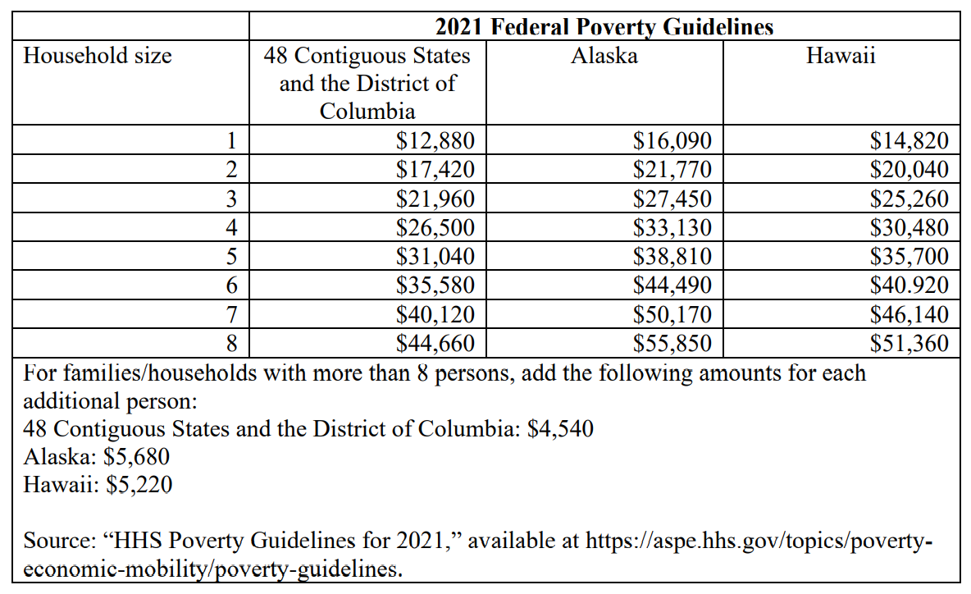

Slide 13
ARPA Eligibility Compliance
Uses of funds must be reasonably designed to benefit the individual or class that experienced the public health impact or harm.
Uses of funds should be assessed based on their responsiveness to their intended beneficiaries and the ability of the response to address the impact or harm experienced by those beneficiaries.
Uses of funds must be related and reasonably proportional to the extent and type of public health impact or harm experienced.
Recipients may also consider the efficacy, cost, cost-effectiveness, and time to delivery of the response.

Slide 14
Eligible Programs & Services
Programs or services that address housing insecurity, lack of affordable housing, or homelessness are eligible. Treasury has determined that supportive housing or other programs or services to improve access to stable, affordable housing among individuals who are homeless, and the development of affordable housing to increase supply of affordable and high-quality living units are responsive to the needs of impacted populations, not only disproportionately impacted populations, and promote long-term housing security.
Public Services such as food assistance; services for prevention, treatment, recovery, and harm reduction for mental health, substance use, and other behavioral health challenges caused or exacerbated by the public health emergency.
Emergency housing assistance such as rent, mortgage, or utility assistance and counseling and legal aid to prevent eviction or homelessness. Rental arrears, utility costs or arrears, reasonable accrued late fees, mortgage payment assistance, financial assistance to allow a homeowner to reinstate a mortgage or to pay other housing-related costs related to a period of forbearance, delinquency, or default, mortgage principal reduction, facilitating mortgage interest rate reductions, counseling to prevent foreclosure or displacement, relocation expenses following eviction or foreclosure (e.g., rental security deposits, application or screening fees) assistance to households for delinquent property taxes to prevent tax foreclosures on homes.
Housing stability services that enable eligible households to maintain or obtain housing, such as housing counseling, fair housing counseling, case management related to housing stability, outreach to households at risk of eviction or promotion of housing support programs, housing related services for survivors of domestic abuse or human trafficking, and specialized services for individuals with disabilities or seniors that support their ability to access or maintain housing, as well as legal aid such as legal services or attorney’s fees related to eviction proceedings and maintaining housing stability, court-based eviction prevention or eviction diversion programs, and other legal services that help households maintain or obtain housing.
Emergency assistance for individuals experiencing homelessness, either individual-level assistance (e.g., rapid rehousing services) or assistance for groups of individuals (e.g., master leases of hotels, motels, or similar facilities to expand available shelter).

Slide 15
Eligible Programs & Services continued…
Rental assistance to support low-income households in securing stable, long-term housing, including housing vouchers, residential counseling, or housing navigation assistance to facilitate household moves to neighborhoods with high levels of economic opportunity and mobility for low-income residents.
Permanent supportive housing or other programs or services to improve access to stable, affordable housing among individuals who are homeless, and the development of affordable housing to increase supply of affordable and high-quality living units are eligible. Both the development of affordable housing and wrap-around services such as behavioral health services, employment services, and other supportive services, are eligible responses to the public health crisis or its negative economic impacts. Operating expenses for eligible affordable housing project are an eligible use of ARPA funds.
Shelters for homeless, victims of violence, behavioral and mental health facilities, and transitional shelters (e.g., temporary residences for people experiencing homelessness) are eligible capital expenditures.
Development of affordable housing, including services that primarily increase access to affordable, high-quality housing and support stable housing and homeownership over the long term. To further support sustainable and durable homeownership, recipients may consider offering down payment assistance. Homeownership assistance that would be eligible under the Community Development Block Grant (at 24 CFR 507.201(n)) is also an eligible use of ARPA funds.
The treatment of grants to support affordable housing development, including developments supported by the Low-Income Housing Tax Credits (LIHTC) are an eligible use of funds

Slide 16
Affordable Housing
As with all interventions to address the negative economic impacts of the pandemic, affordable housing projects must be responsive and proportional to the harm identified.
Affordable housing development projects, which may involve large expenditures and capital investments, are eligible if the development increases the supply of long-term affordable housing for low-income households. While there may be less costly (or non-capital) alternatives to affordable housing development, a comprehensive response to the widespread housing challenges underscored by the pandemic will require the production of additional affordable homes, and targeted affordable housing development is a cost-effective and proportional response to this need.
The Final Rule provides that the ongoing pandemic and resulting economic crisis are having a profound, long-term negative effect on the pre-existing affordable housing crisis facing low-income households, and further acknowledges that affordable housing is not confined to low-income geographies; therefore, assistance outside of low-income geographies (such as qualified census tracts) is eligible. The Final Rule also states that affordability criteria must be applied to affordable housing development projects, and that the term “development” should include construction, preservation, rehabilitation, and operation.
Treasury will presume that any projects that would be eligible for funding under either the National Housing Trust Fund (HTF) or the Home Investment Partnerships Program (HOME) are eligible uses of ARPA funds. **
** Note that these programs use different income limits than the definition of low- and moderate-income adopted by Treasury. **

Slide 17
Capital Expenditures
If a recipient intends to fund capital expenditures in response to the public health impacts of the pandemic, recipients should refer to the ‘Capital Expenditures’ section of the Final Rule for details about the eligibility of capital expenditures. This section provides
  an overview of general standards governing capital expenditures;
  presumptions on capital expenditures, which help guide recipients in determining whether the expenditure meets the standards and the associated documentation requirements; and
  additional standards and requirements that may apply.
The Final Rule expressly states:
Among other requirements contained in 2 CFR 200, Appendix II, all contracts made by a recipient or subrecipient in excess of $100,000 with respect to a capital expenditure that involve employment of mechanics or laborers must include a provision for compliance with certain provisions of the Contract Work Hours and Safety Standards Act, 40 U.S.C. 3702 and 3704, as supplemented by Department of Labor regulations (29 CFR Part 5).
All projects must comply with applicable federal, state, and local law. In the case of capital expenditures, this includes environmental and permitting laws and regulations. Likewise, as with all capital expenditure projects using the ARPA funds, projects must be completed in a manner that is technically sound, meaning that it must meet design and construction methods and use materials that are approved, codified, recognized, fall under standard or acceptable levels of practice, or otherwise are determined to be generally acceptable by the design and construction industry.
The Uniform Guidance at 2 C.F.R. 200 applies to capital expenditures unless stated otherwise. Importantly, this includes 2 C.F.R. 200 Subpart D on post-federal award requirements, including property standards pertaining to insurance coverage, real property, and equipment; procurement standards; subrecipient monitoring and management; and record retention and access.

Slide 18
Capital Expenditures of $1 million or greater
Treasury will require projects with total expected capital expenditure costs of $1 million or greater to undergo additional analysis to justify their capital expenditure. Increased reporting requirements will be required. For projects with total expected capital expenditures of $1 million or greater, recipients must complete and meet the substantive requirements of a Written Justification for their capital expenditure.
This Written Justification helps clarify the application of Treasury’s interpretive framework to capital expenditures, while recognizing that the needs of communities differ. This justification reflects the fact that the time required for a large construction project may make capital expenditures less “responsive” to pandemic-related needs relative to other types of responses. All ARPA funds must be obligated by December 31, 2024 and expended by December 31, 2026. Capital expenditures may involve long lead times, and the Written Justification may support recipients in analyzing proposed capital expenditures to confirm that they conform to the obligation and expenditure timing requirements.
The Written Justification establishing consistent documentation and reporting to support monitoring and compliance with the ARPA and final rule. Finally, the Written Justification also reflects the fact that infrastructure projects are generally not within scope of this eligible use category.
The Written Justification should (1) describe the harm or need to be addressed; (2) explain why a capital expenditure is appropriate to address the harm or need; and (3) compare the proposed capital expenditure against alternative capital expenditures that could be made. The information required for the Written Justification reflects the framework applicable to all uses under the public health and negative economic impacts eligible use category, providing justification for the reasonable design, relatedness, and reasonable proportionality of the capital expenditure in response to the harm or impact identified.
Projects with total expected capital expenditures below $1 million will not be required to undergo additional analysis to justify their capital expenditure, as such projects will be presumed to be reasonably proportional, provided that they are responding to a harm caused or exacerbated by the public health emergency

Slide 19
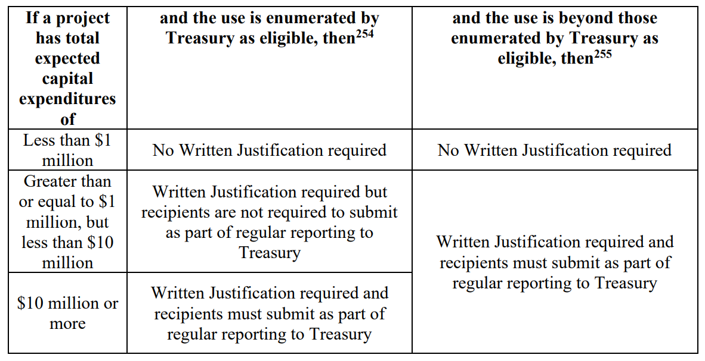

Slide 20
Construction Projects
Treasury encourages recipients to use strong labor standards, including project labor agreements (PLAs) and community benefits agreements that offer wages at or above the prevailing rate and include local hire provisions.
Treasury also recommends that recipients prioritize in their procurement decisions employers who can demonstrate that their workforce meets high safety and training standards (e.g., 206 professional certification, licensure, and/or robust in-house training), that hire local workers and/or workers from historically underserved communities, and who directly employ their workforce or have policies and practices in place to ensure contractors and subcontractors meet high labor standards.
Treasury further encourages recipients to prioritize employers (including contractors and subcontractors) without recent violations of federal and state labor and employment law.

Slide 21
Public Services
Eligible public services include any activity which seeks to address homelessness and affordable housing within Palm Bay city limits, to include the provision of public services. Examples of public services related to homelessness and affordable housing include case management, feeding and sheltering programs, employment services, childcare, mental health or substance abuse services, such as counseling and treatment, etc.
Eligible public services must be 1) a new service, or 2) a quantifiable increase in the level of an existing service provided by the applicant or its partner agency. An example of a quantifiable increase is an increase in the number of new individuals or households served.

Slide 22
Questions?

